Slide 1

Introduction to digital manufacturing
TERM PROJECT

Slide 2
FOLDING BRACKET 1
MODELLING

Slide 3
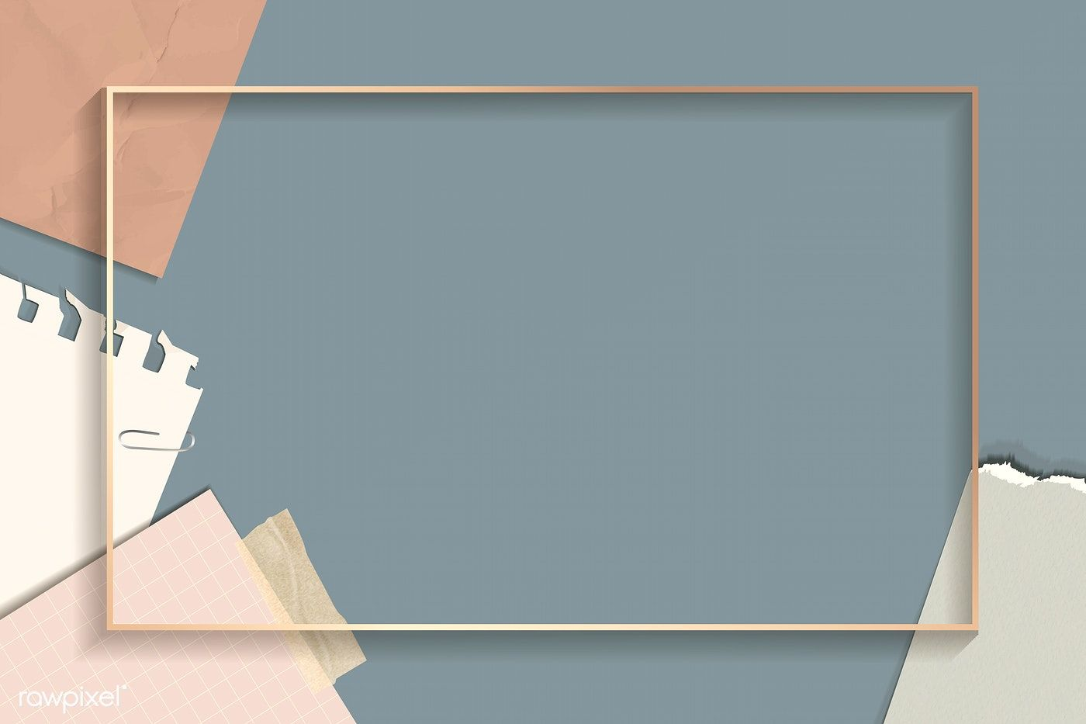
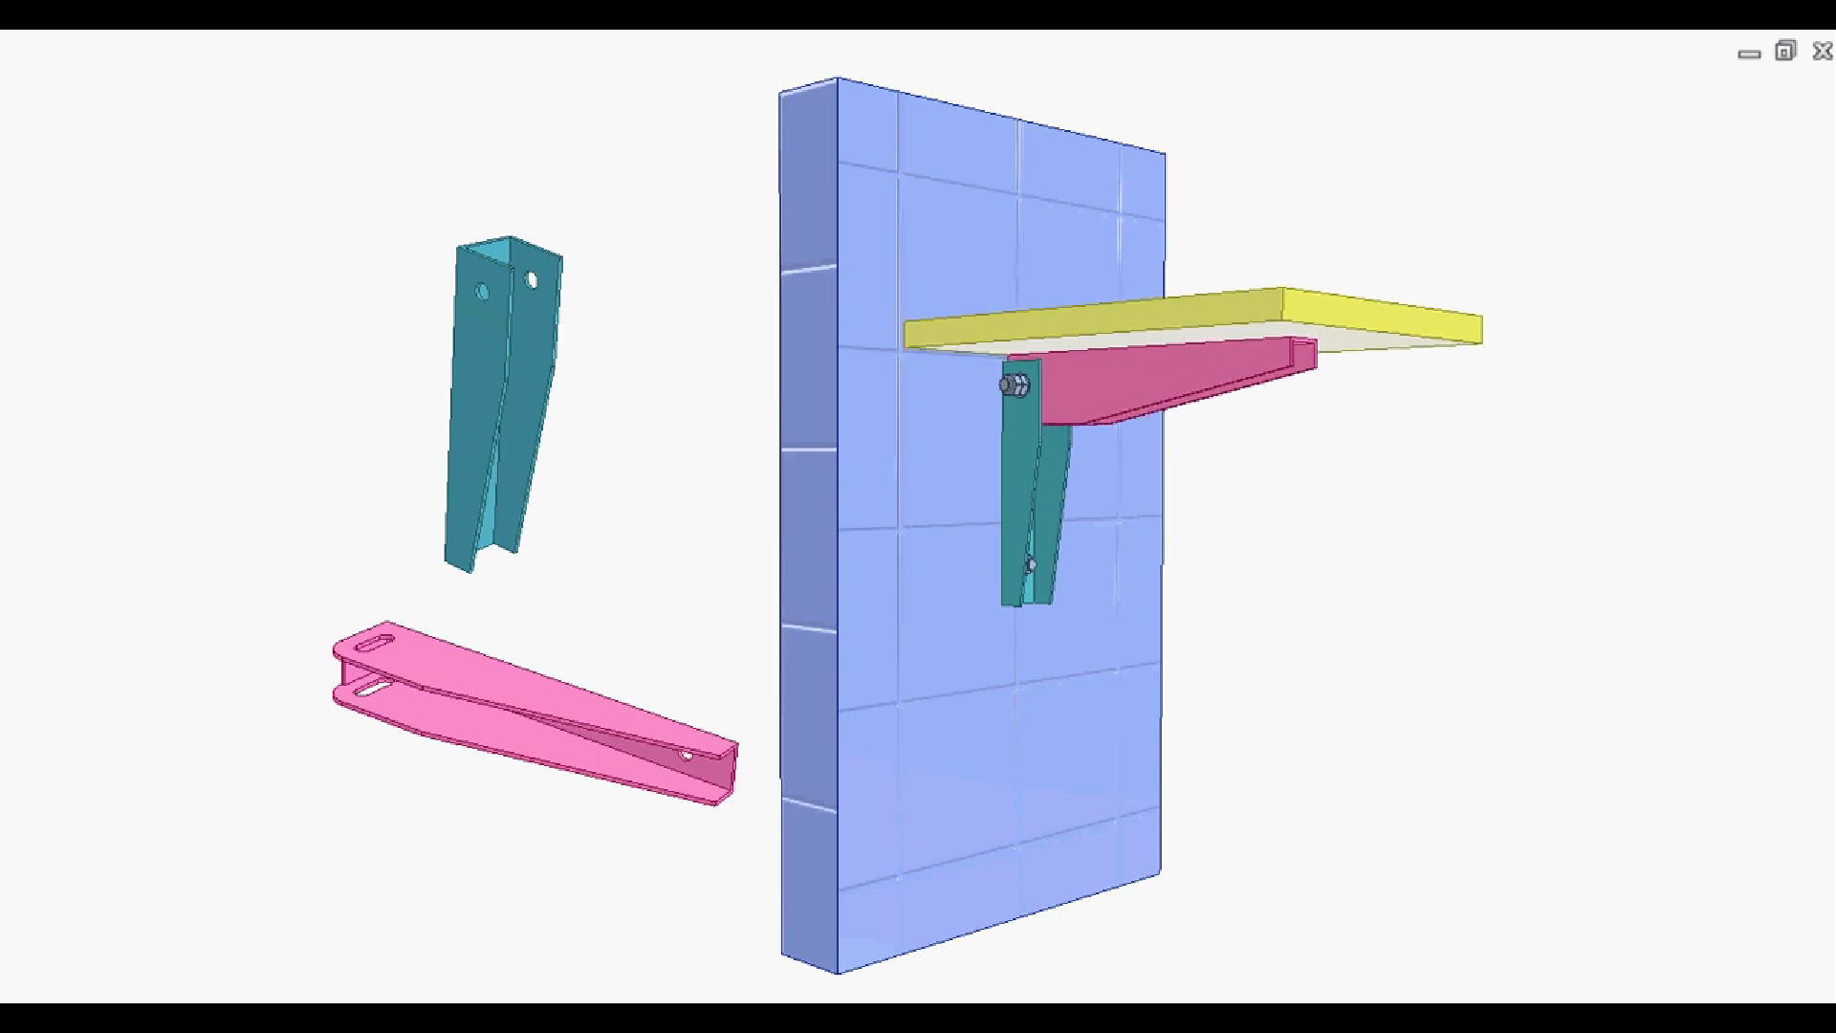
Modelling of the folding bracket involves modelling of 7 different parts. Namely,
Blue wall
Green bracket
Pink bracket
Yellow pad
4 Screws
1 bolt
1 nut

Slide 4
BLUE WALL
MODELLING

Slide 5
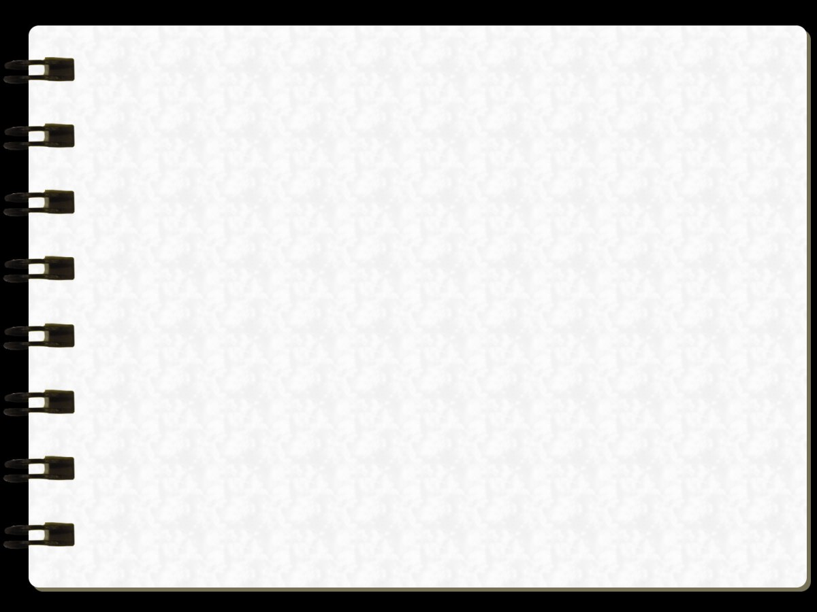
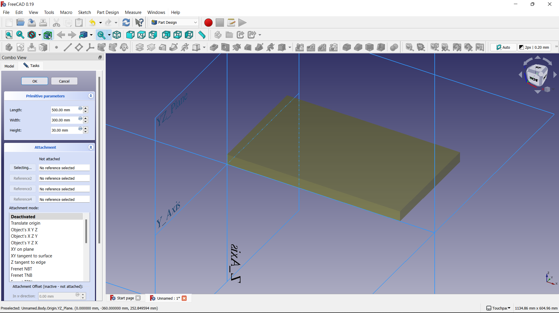
The first step involved in modelling the blue wall is to create a cuboid of dimensions of our choice.
Open freecad, go to part design, then click on additive cube and now change the dimensions as length = 500mm, width = 300mm, and height = 30 mm

Slide 6
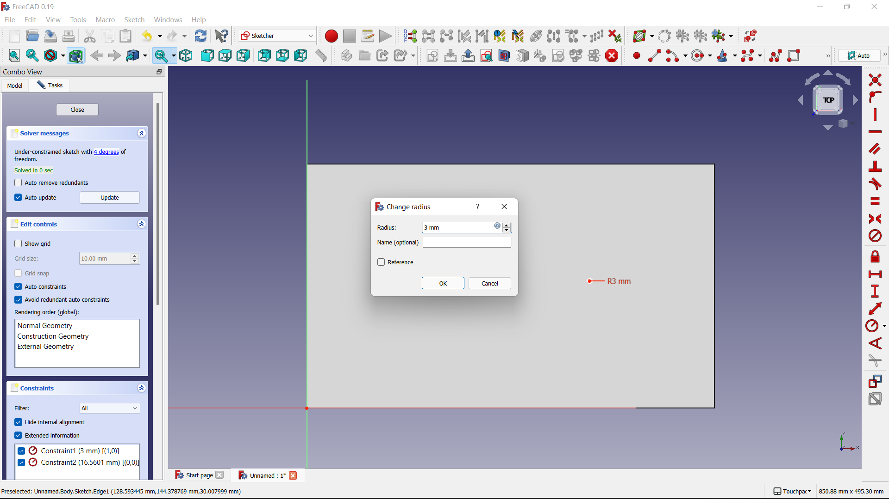
Now select a face and draw two circles of radius 3mm ( for ease we use constraints ).

Slide 7
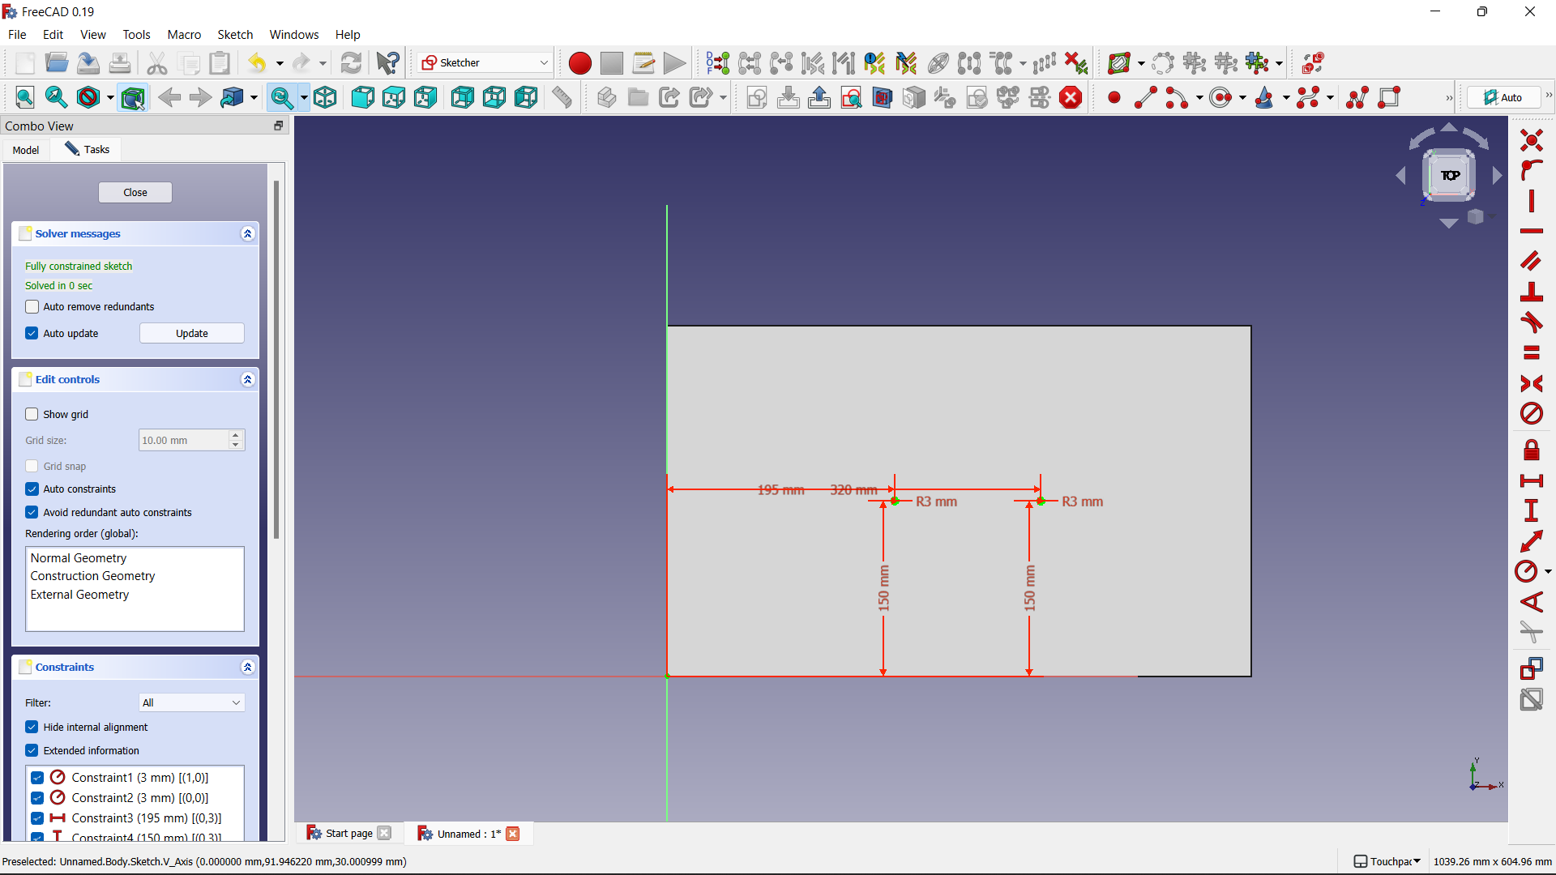
Now add the constraints as shown to the centres of the circles using the lock symbol over here

Slide 8
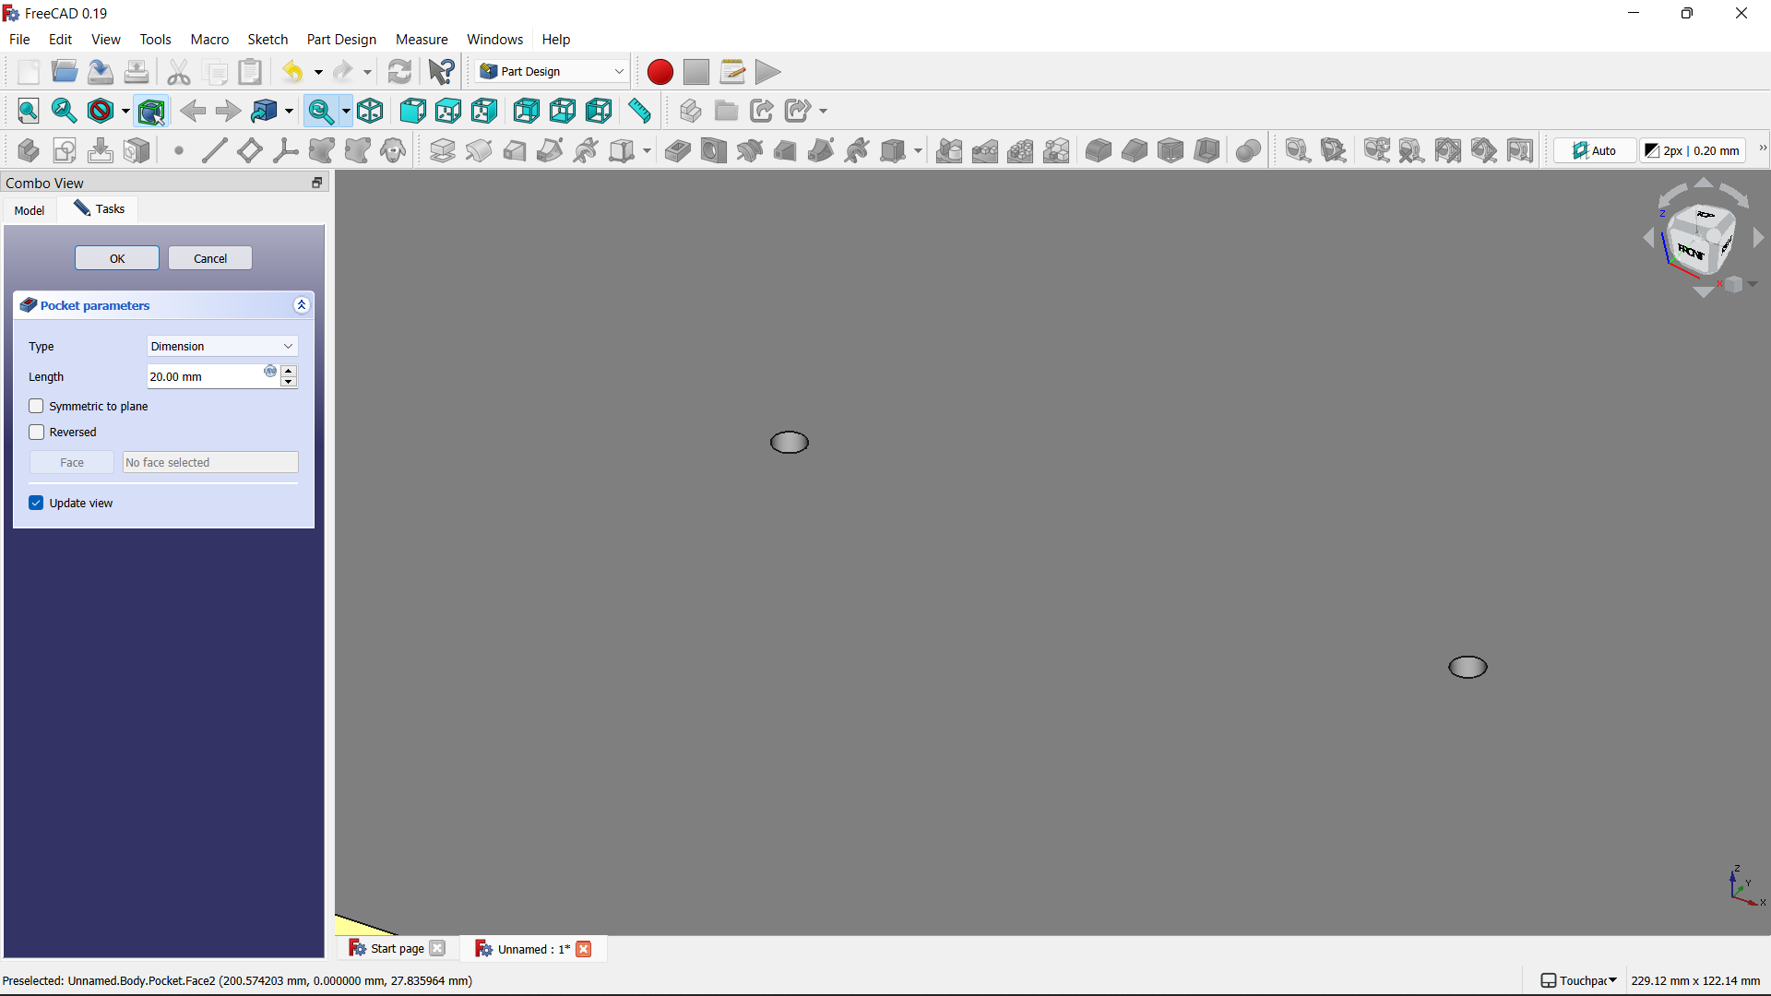
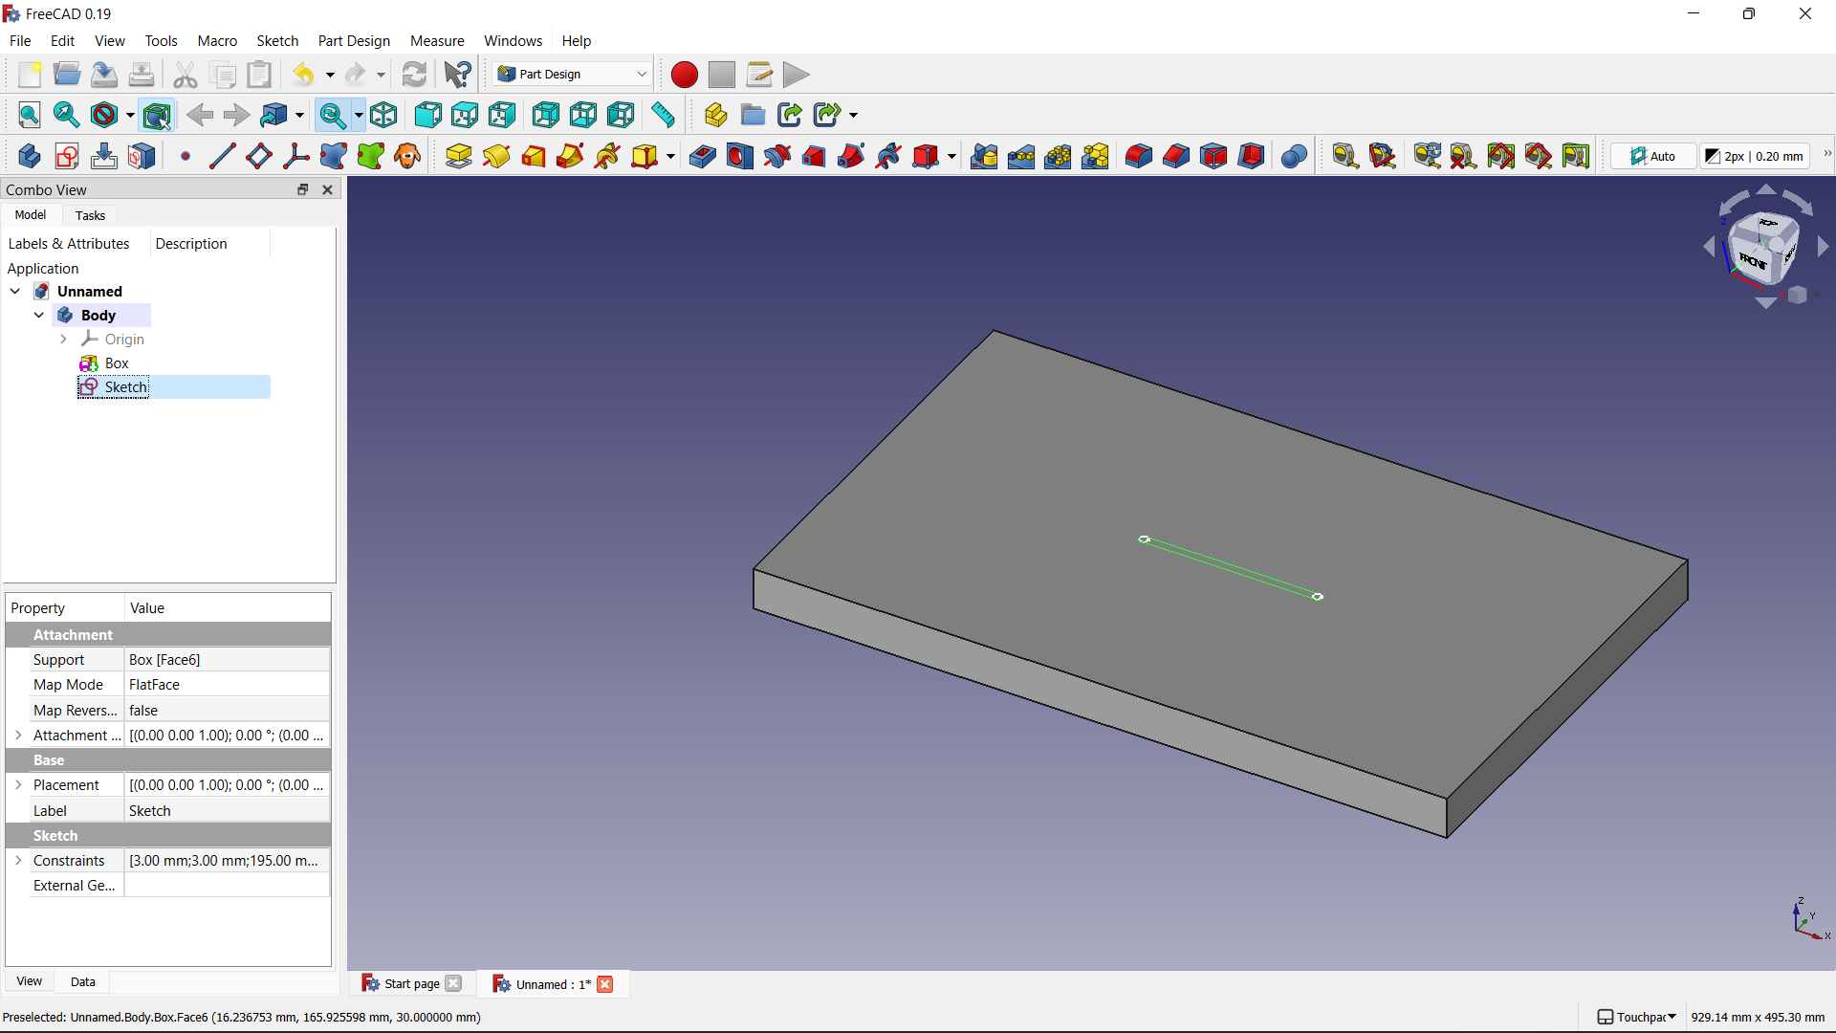
Once you obtain a perfect sketch, select it and pocket it to a height of 20mm.
We can observe a hole in the place of sketches there. The pockets appear as shown on the figure below. So now apply blue colour to the body.

Slide 9
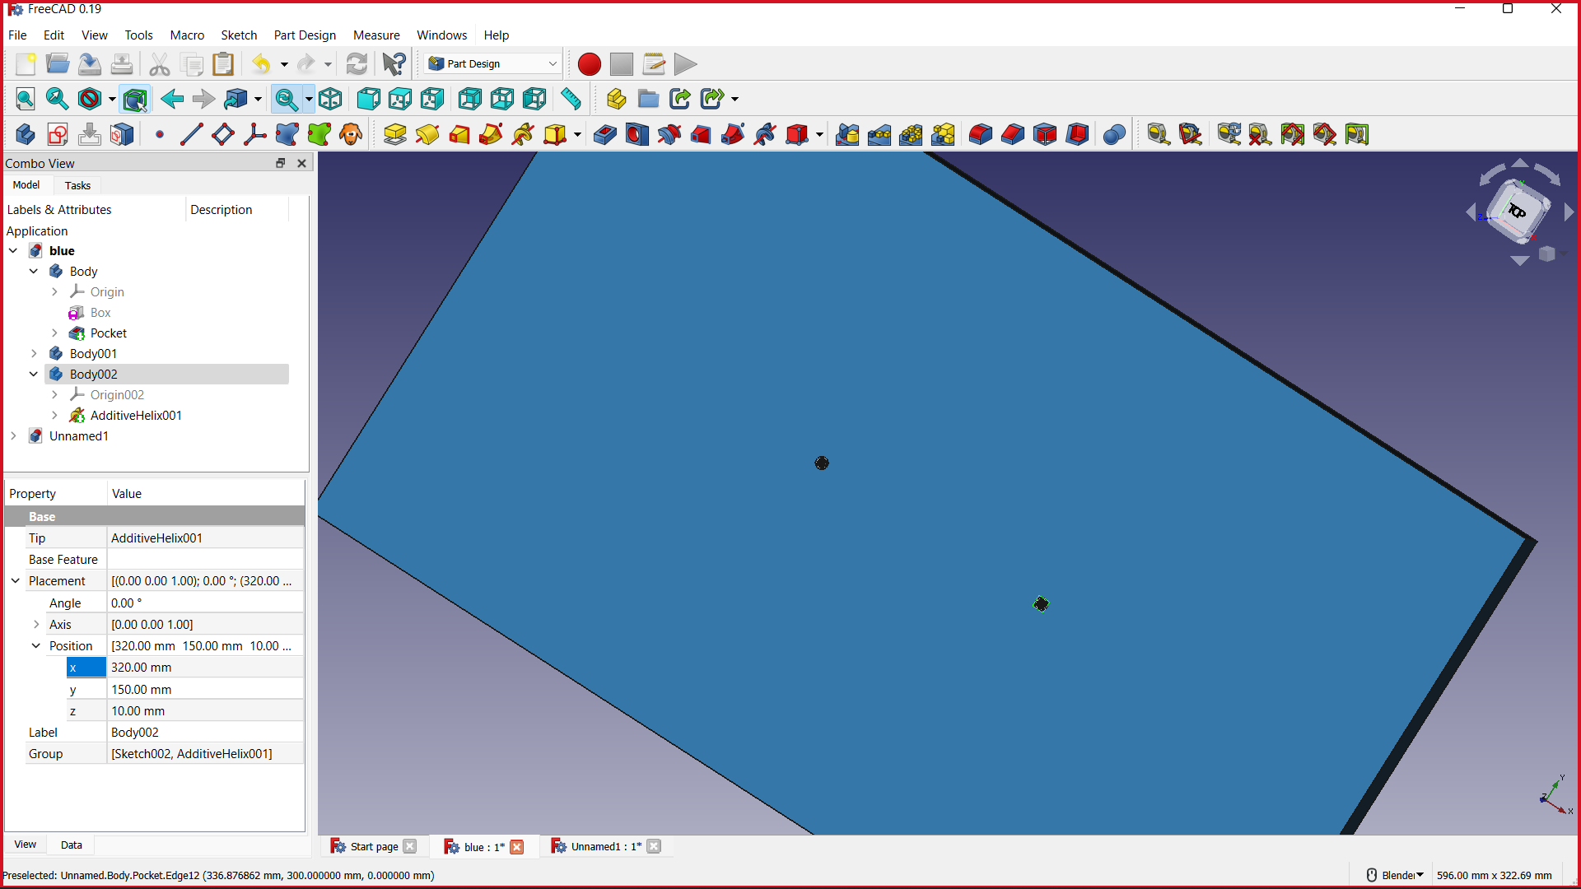
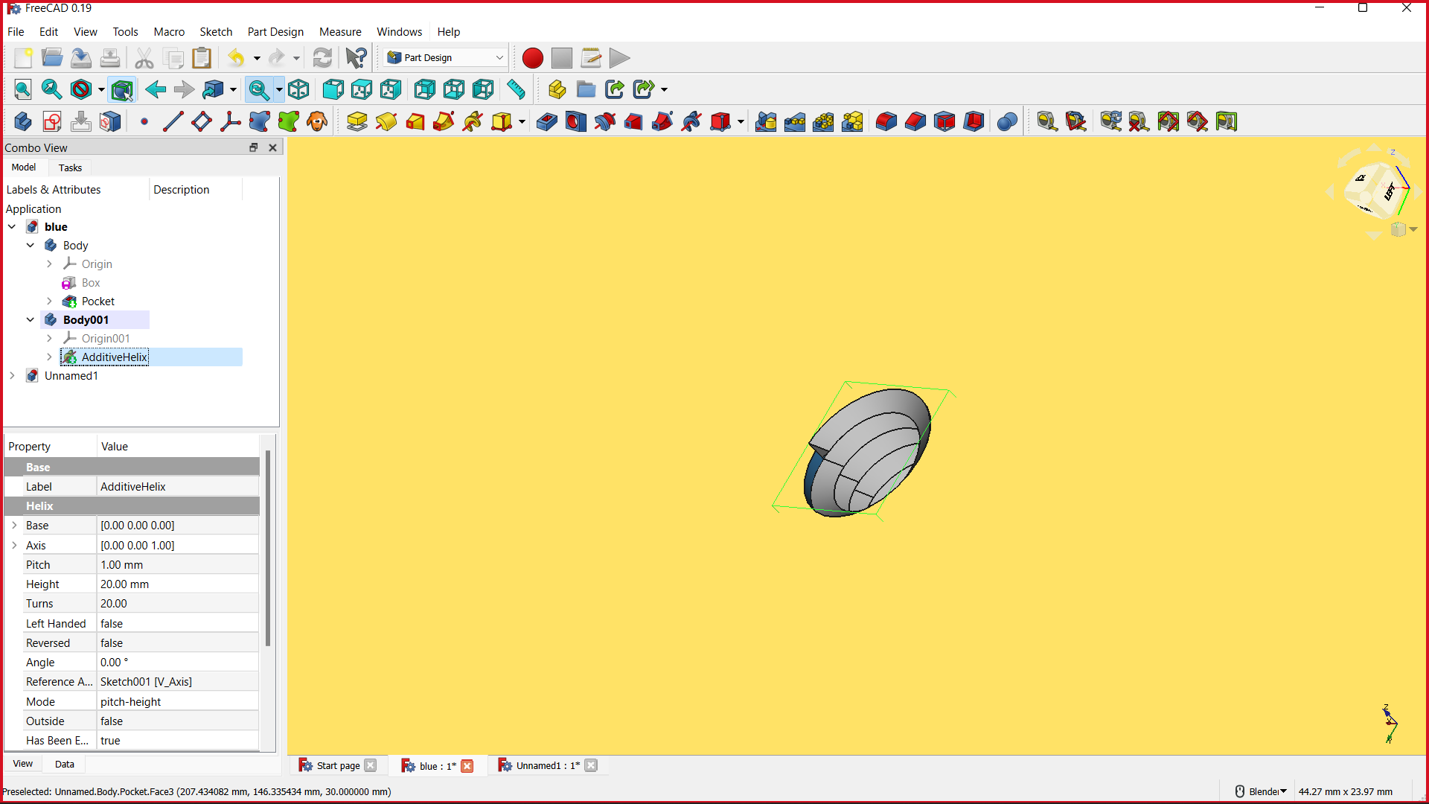
Now add two threaded helices and then use additive sweep option to create a similar structure ( pitch = 0.075, height = 15mm ) which we use to fix this to another part using a bolt or a screw.
The final output of the blue body looks like this.

Slide 10
GREEN BRACKET
MODELLING

Slide 11
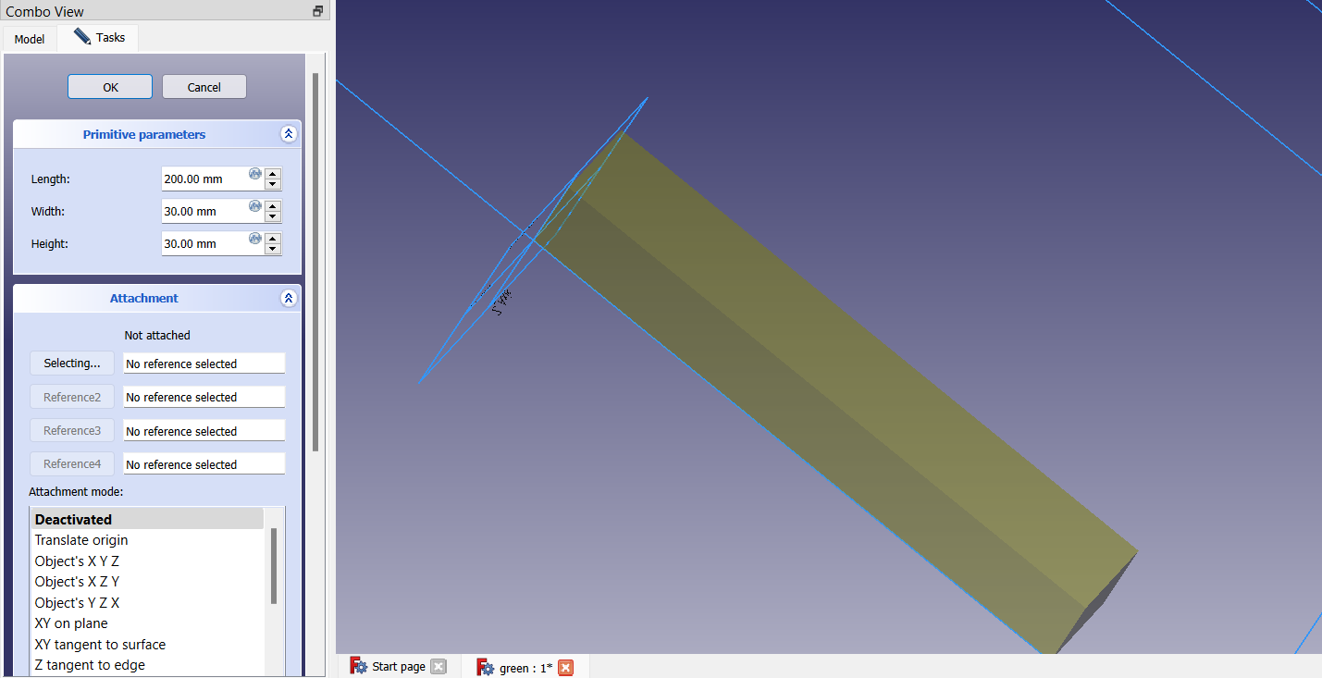
Now to model the green part of the design, create a cuboid of dimensions 200mm,30mm,30mm.

Slide 12
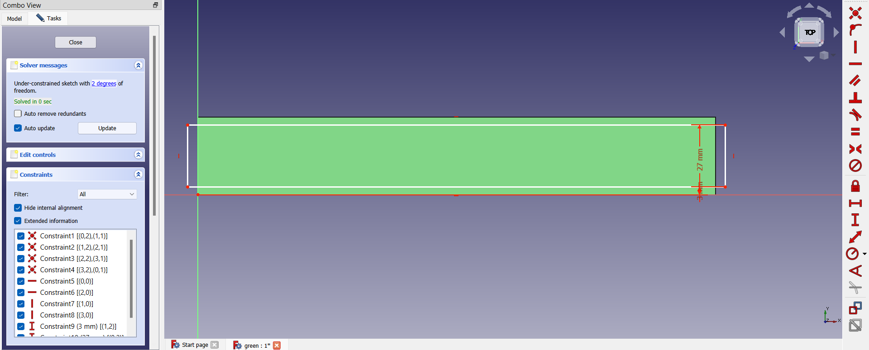
Now select any face and then draw a rectangle of length that exceeds the length of the cuboid and breadth that is 6cm less than the cuboid. Add a constraint of 3mm, 27mm from the X axis for the two lines respectively. Now pocket the rectangle from the body with a depth of 27 mm.

Slide 13
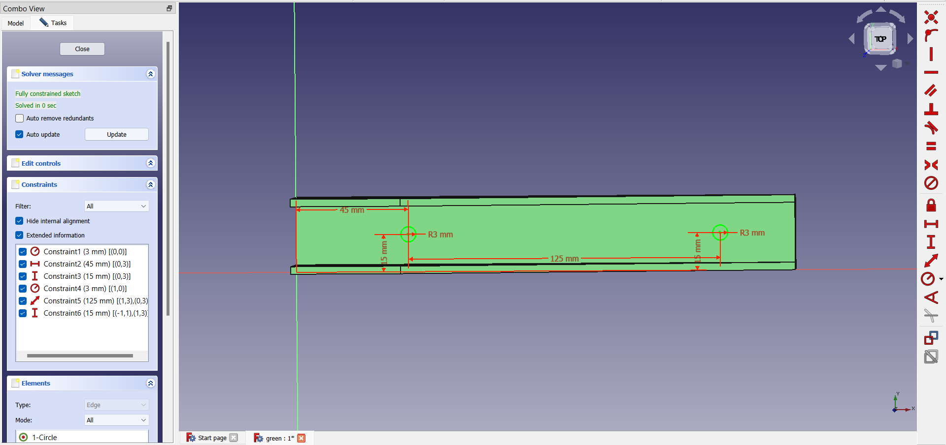
Select the face which is left after pocketing the rectangle in the previous step. Sketch two circles of radius 3mm at a distance of 15mm from the horizontal axis. The distance between the centres of two circles is 125mm, the first circle is placed 45mm distant to the vertical axis. Later pocket the sketches with a depth of 3mm.

Slide 14
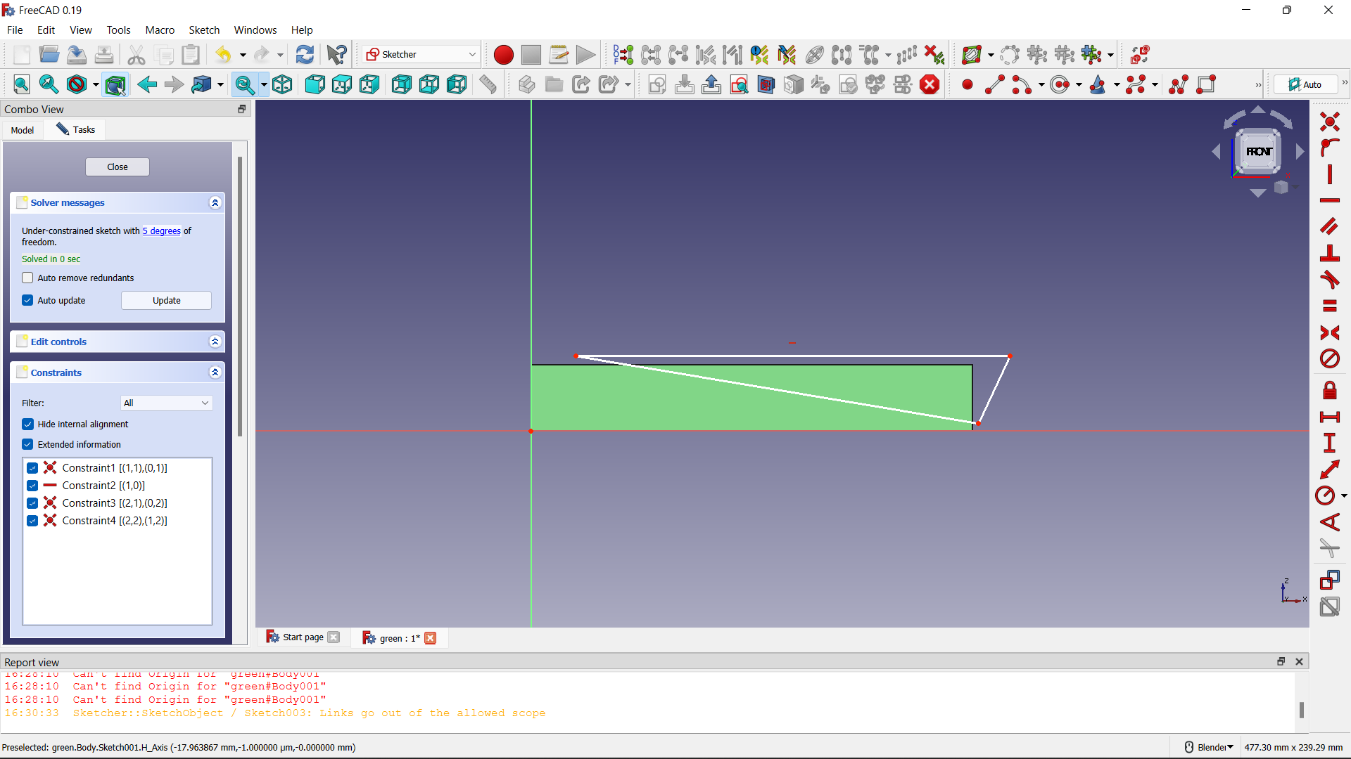
Now select a face that is adjacent to the previously selected one. Now sketch a triangle as shown on that face. Once done with the sketching, pocket the sketch with depth as the width of the cuboid i.e 30mm.

Slide 15
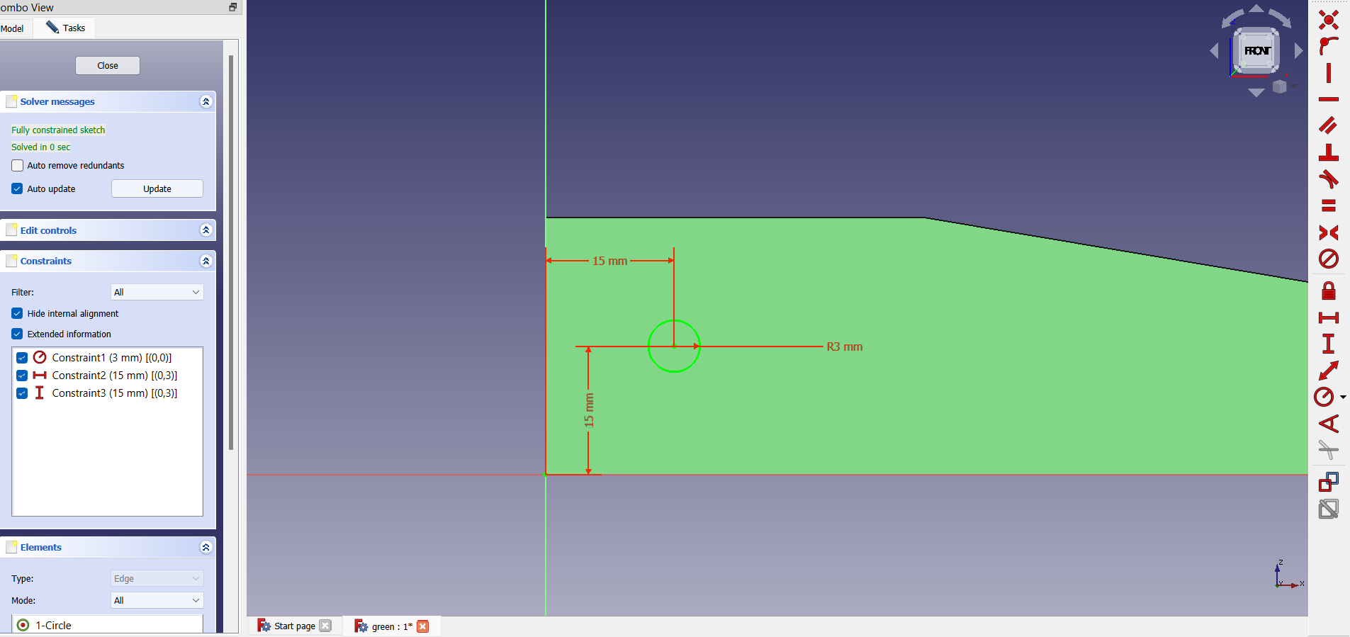
Now on the same face sketch a circle of 3mm radius, placing the centre exactly 15mm distant from both the axes. Then also pocket this sketch with a depth of 30mm (same as the width of the cuboid)

Slide 16
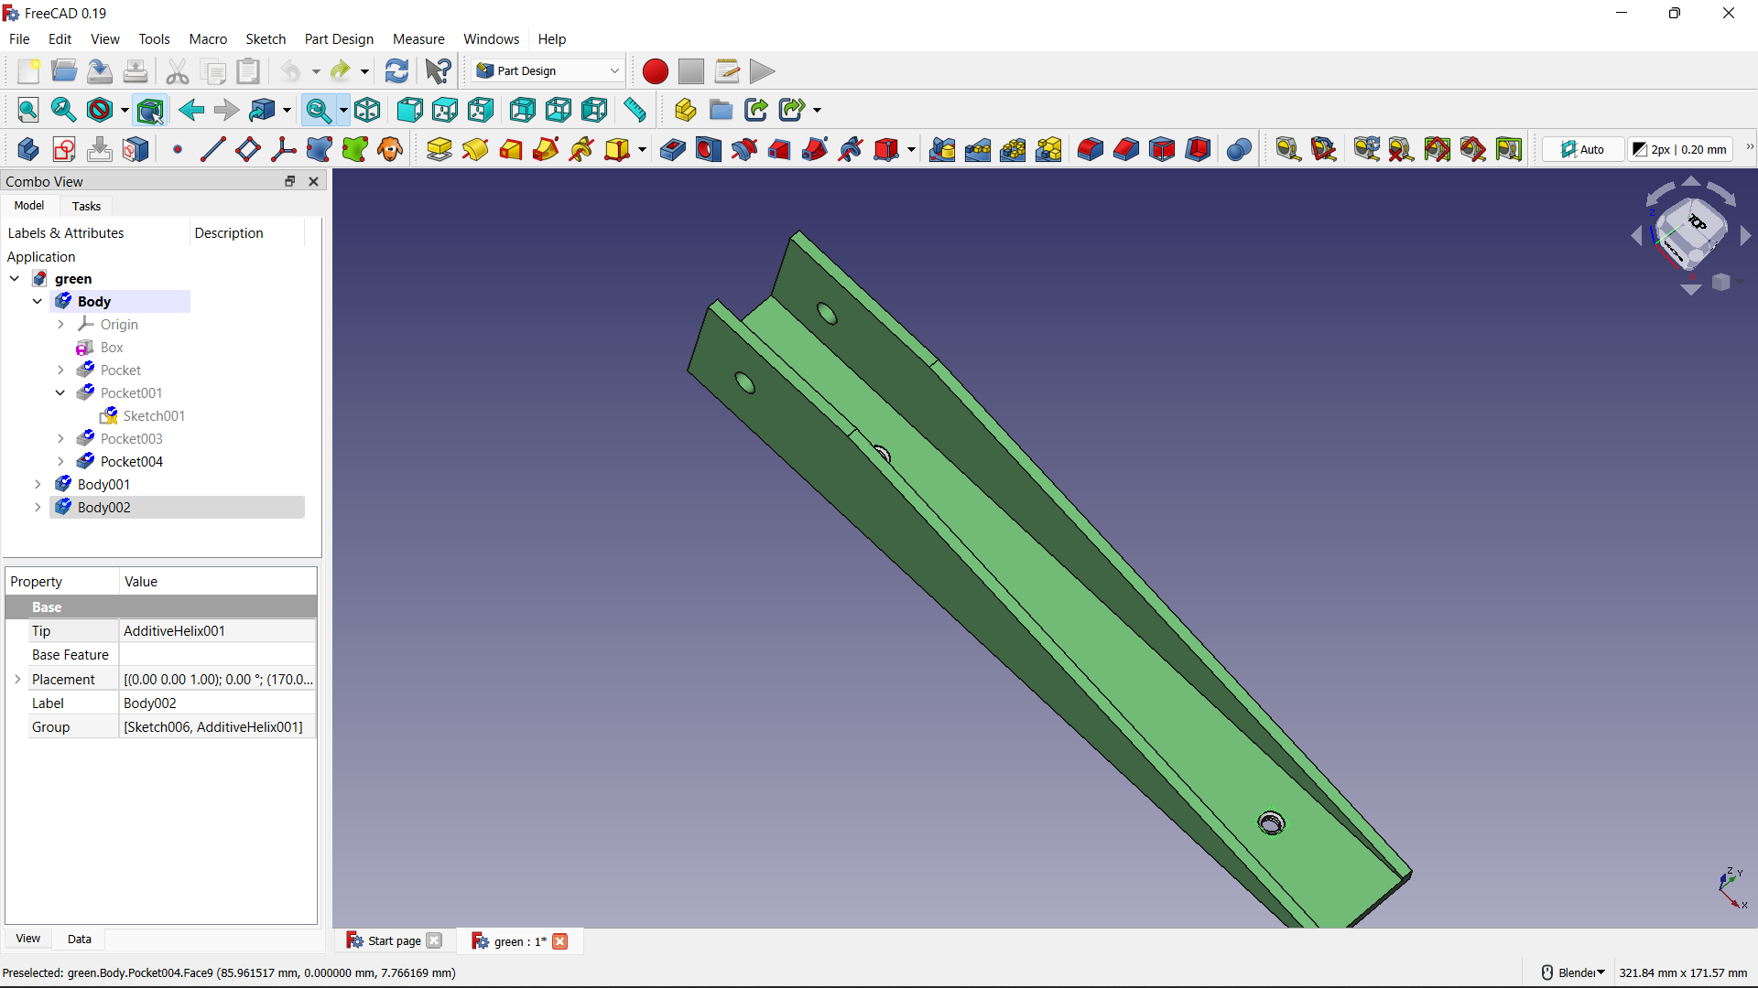
Now add two threaded helices and then use additive sweep option to create a similar structure ( pitch = 0.075, height = 3mm ) which we use to fix this to another part using a bolt or a screw.
The final output of the green body looks like this.

Slide 17
PINK BRACKET
MODELLING

Slide 18
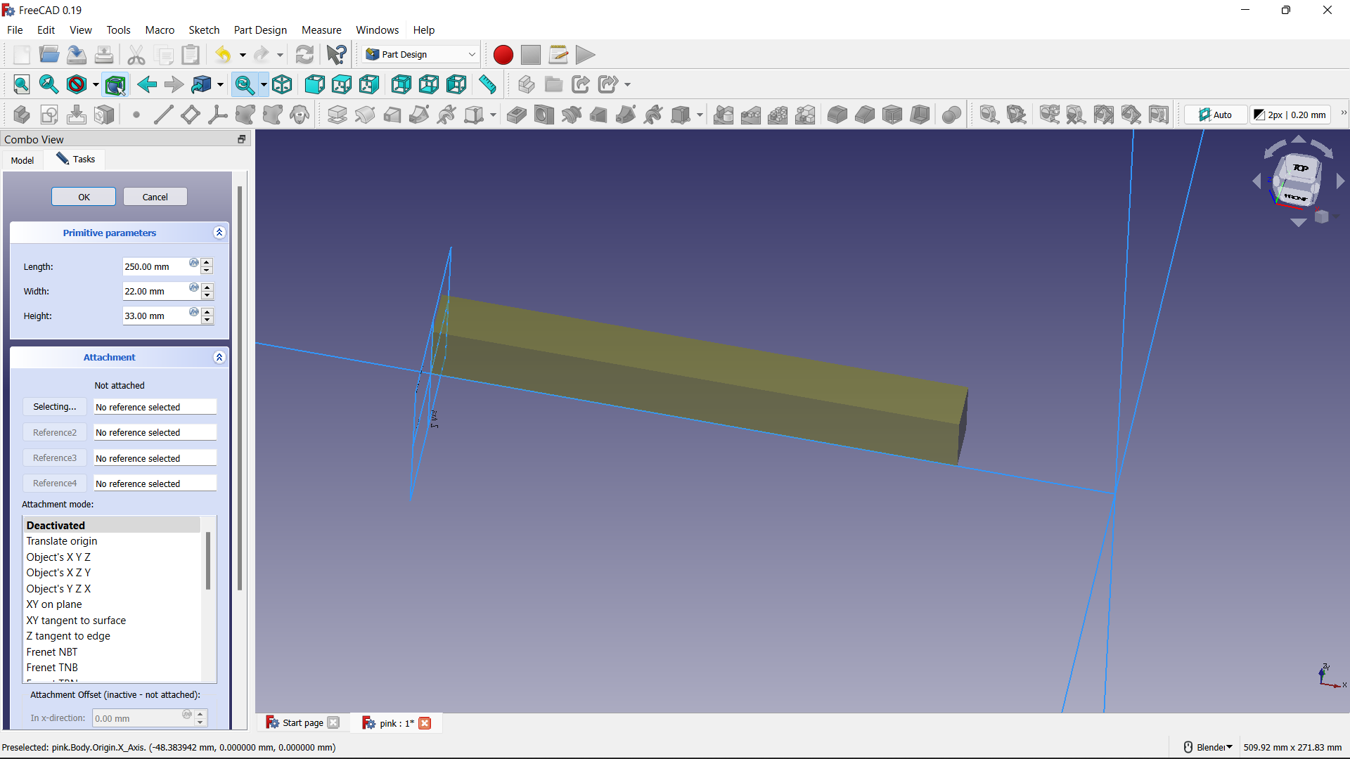
To model the pink bracket, create a cuboid of dimensions 250mm (l),22mm (b),33mm (h)

Slide 19
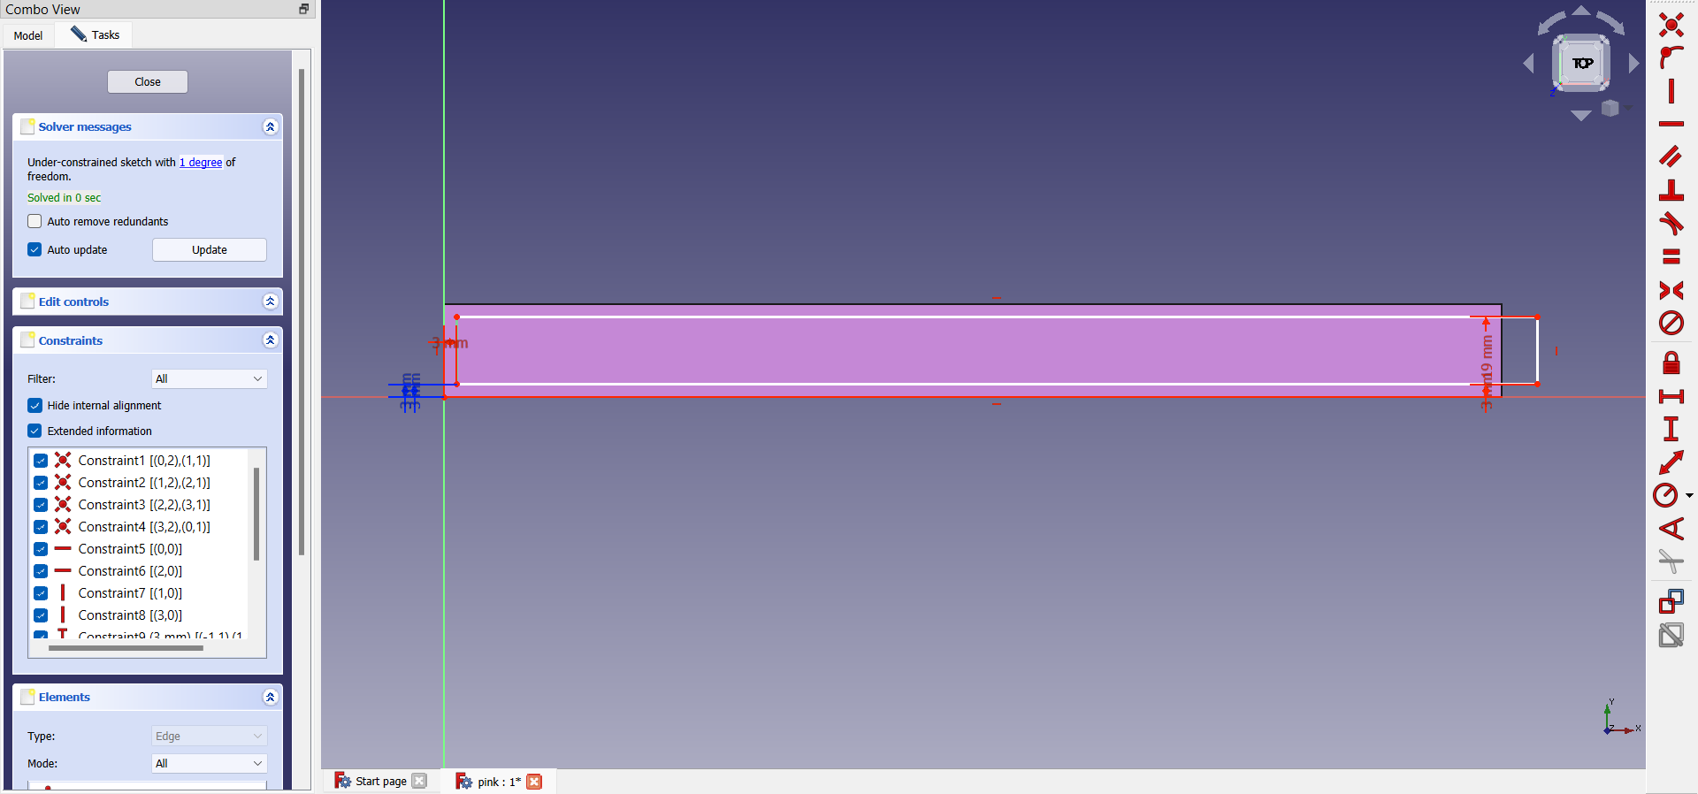
Now create a sketch of any length that exceeds the length of the body and breadth that is 6mm less than that of the cuboid. Use constraints to make it align in a perfect way as shown. Then pocket it with a depth of 30mm.

Slide 20
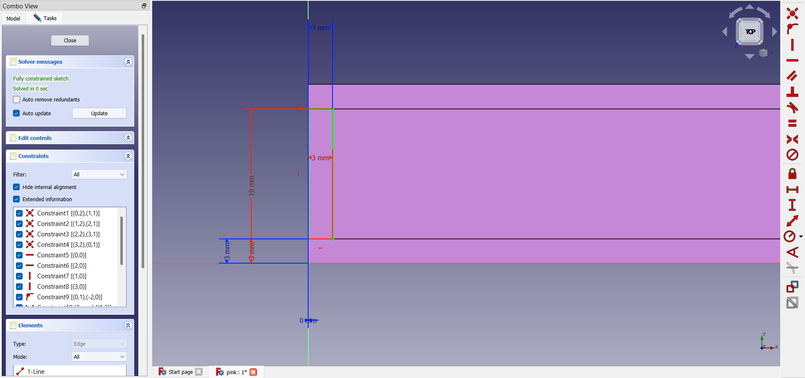
Now select the same face and draw a rectangle of length 16mm and breadth 3 mm at the place where we left before, use constraints to make it align at 3mm distant from the origin. Now pocket the sketch for a depth of 6mm.

Slide 21
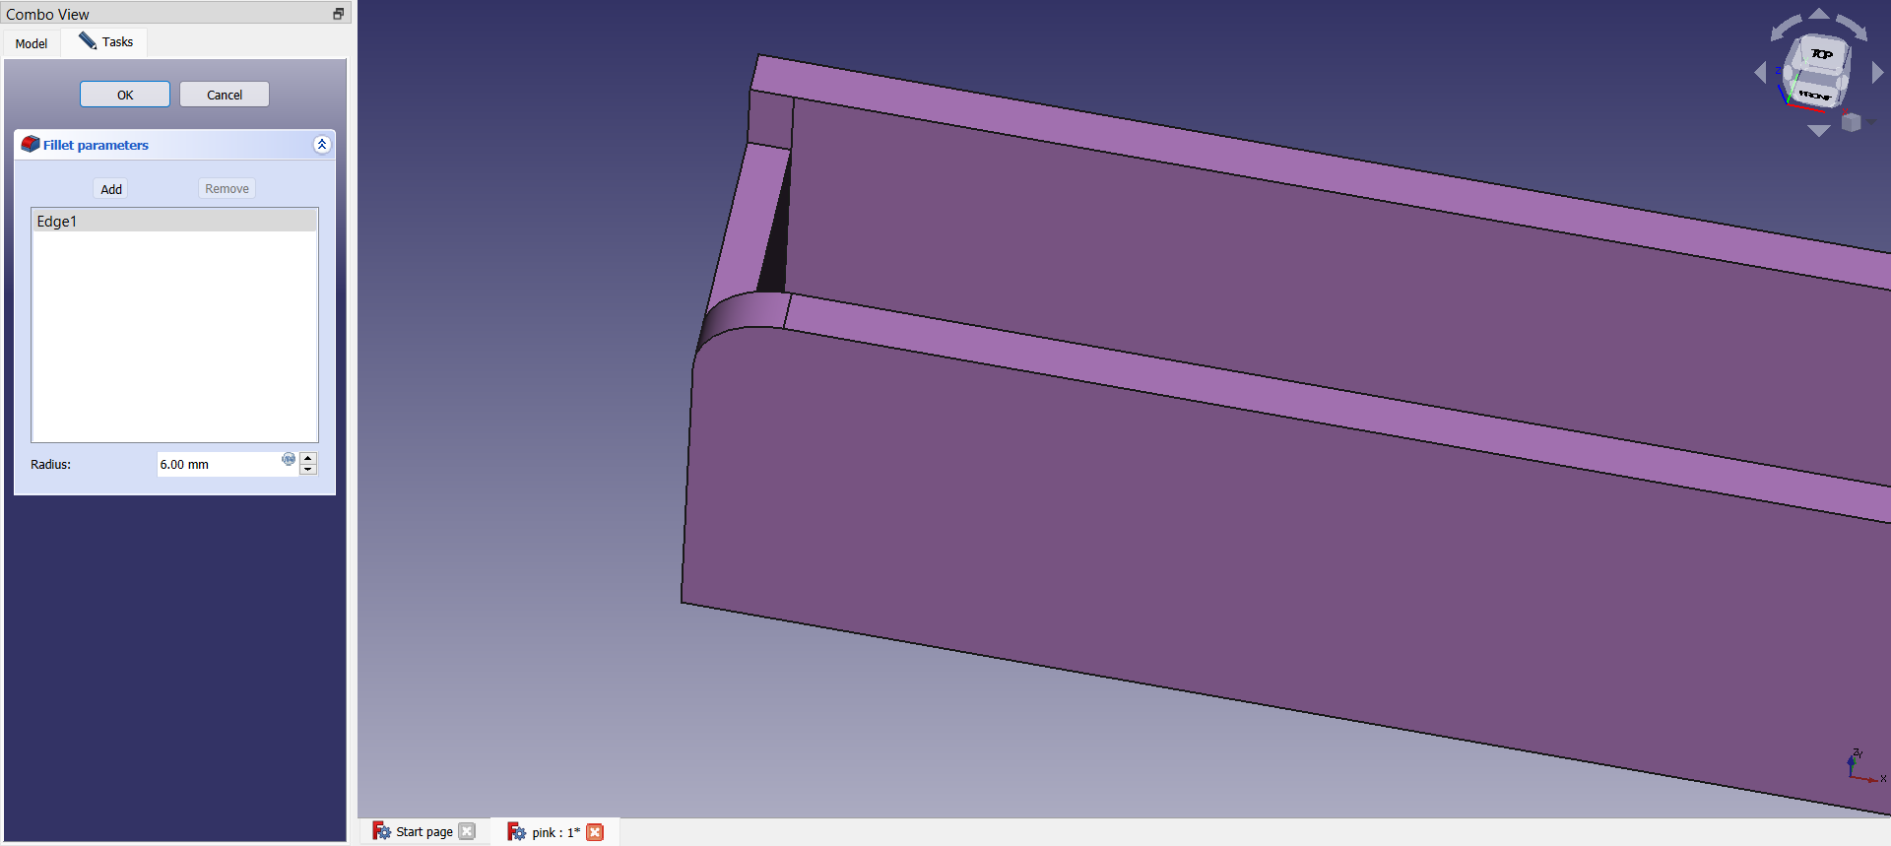
Select the edge where we pocketed and then make a fillet of radius 6mm there. Repeat it for the other edge too.

Slide 22
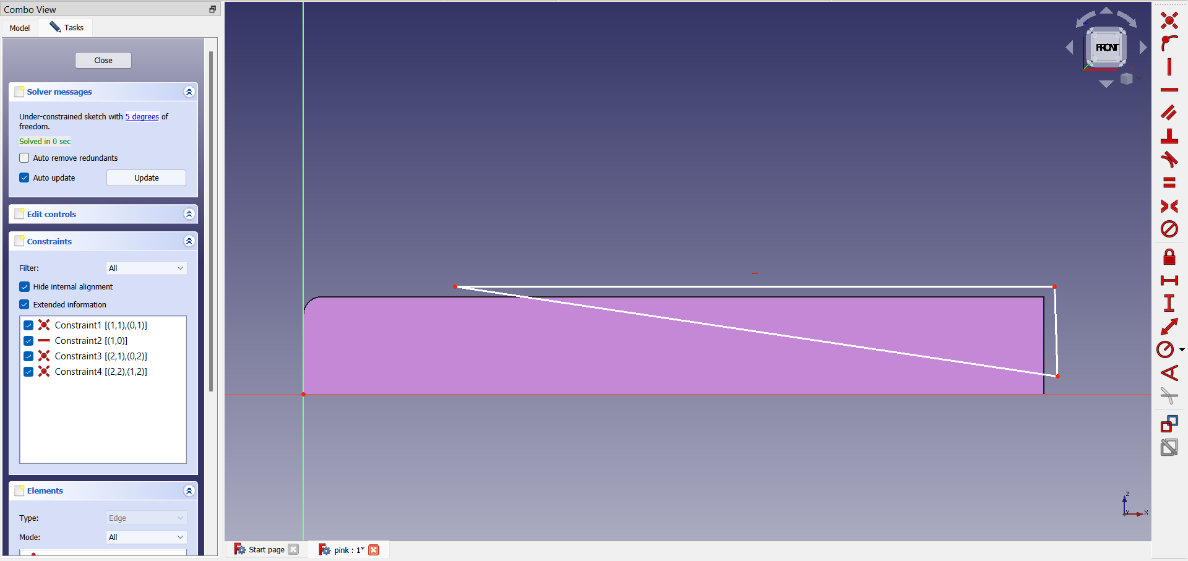
Select the face that is adjacent to the previously selected one. Now draw a triangle as shown ( the dimensions may vary ) After sketching, pocket it for a depth of 22mm i.e width of the cuboid

Slide 23
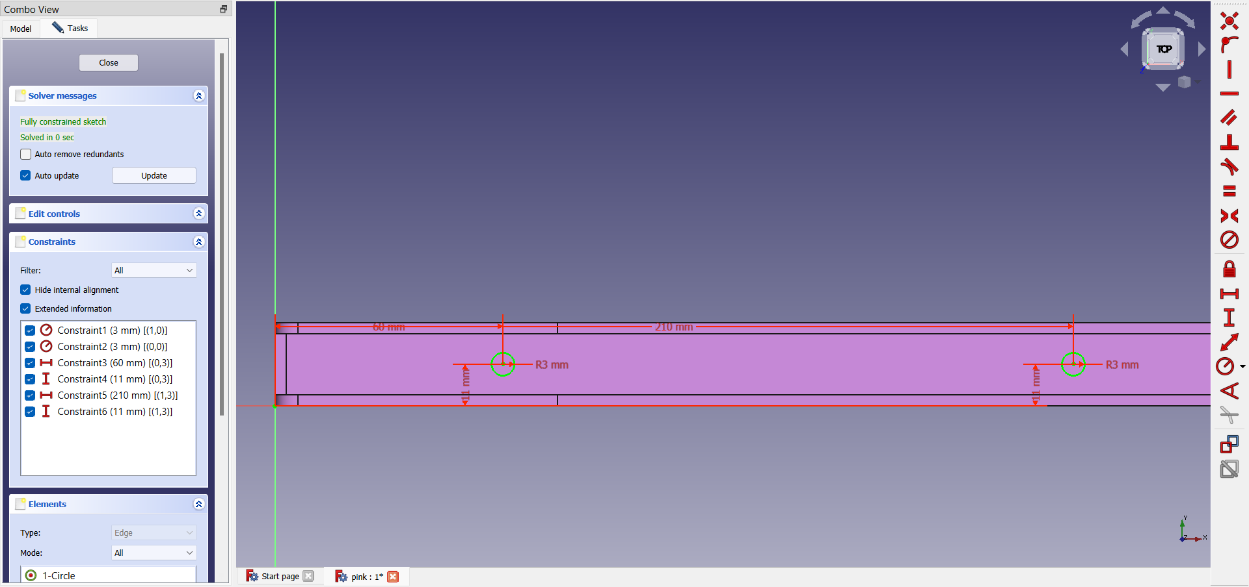
Draw 2 circles of radius 3mm at distance of 60mm, 210mm from the vertical axis, 11mm from the horizontal axis respectively. Pocket the sketches.

Slide 24
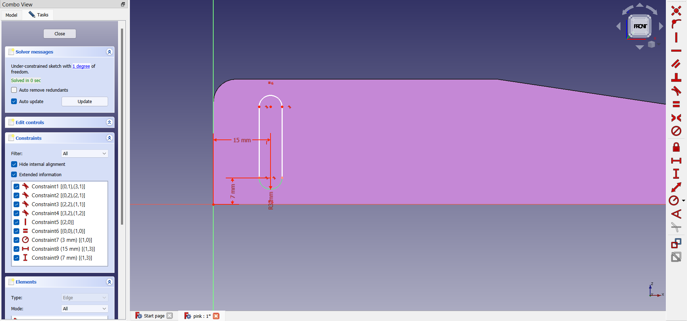
Select the face where we have drawn the triangle and sketch an ellipse with dimensions shown, place one of its foci (the bottom one) at a distance of 15mm from the vertical axis, 7mm from the horizontal axis. Now pocket it.

Slide 25
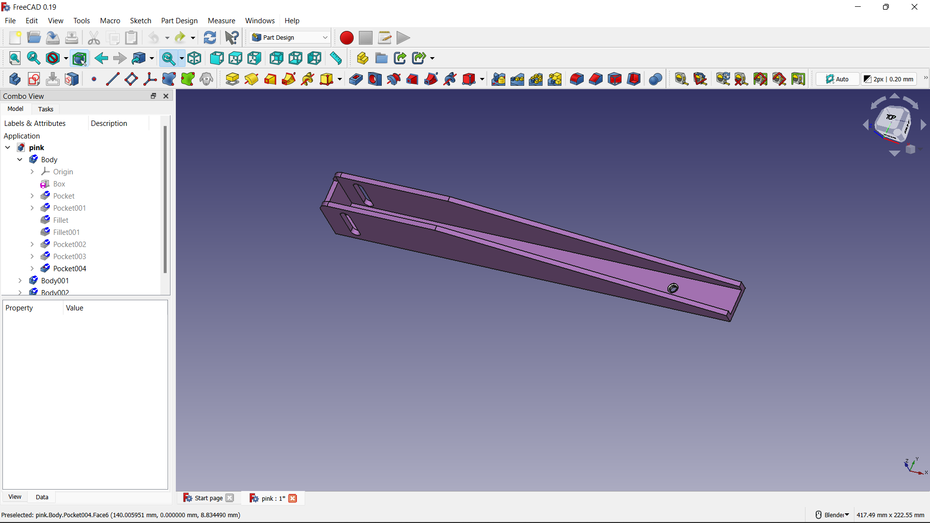
Now add two threaded helices and then use additive sweep option to create a similar structure ( pitch = 0.075, height = 3mm ) which we use to fix this to another part using a bolt or a screw.
The final output of the pink body looks like this.

Slide 26
YELLOW PAD
MODELLING

Slide 27
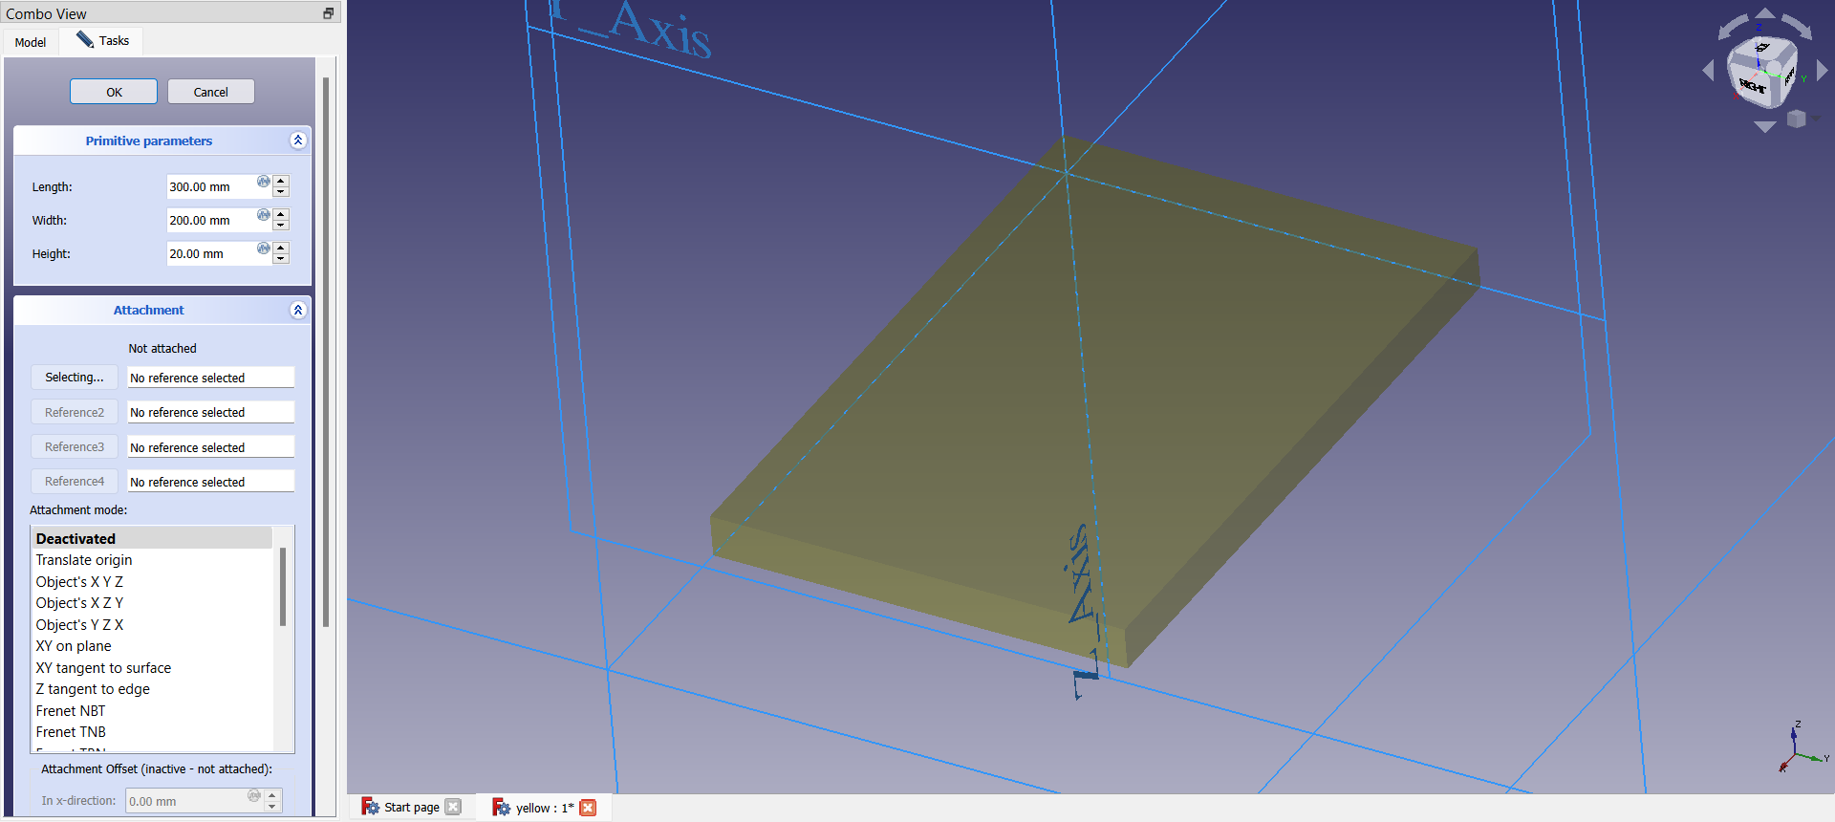
Create a cuboid or additive box of dimensions 300mm (l) ,200mm (b) ,20mm (h).

Slide 28
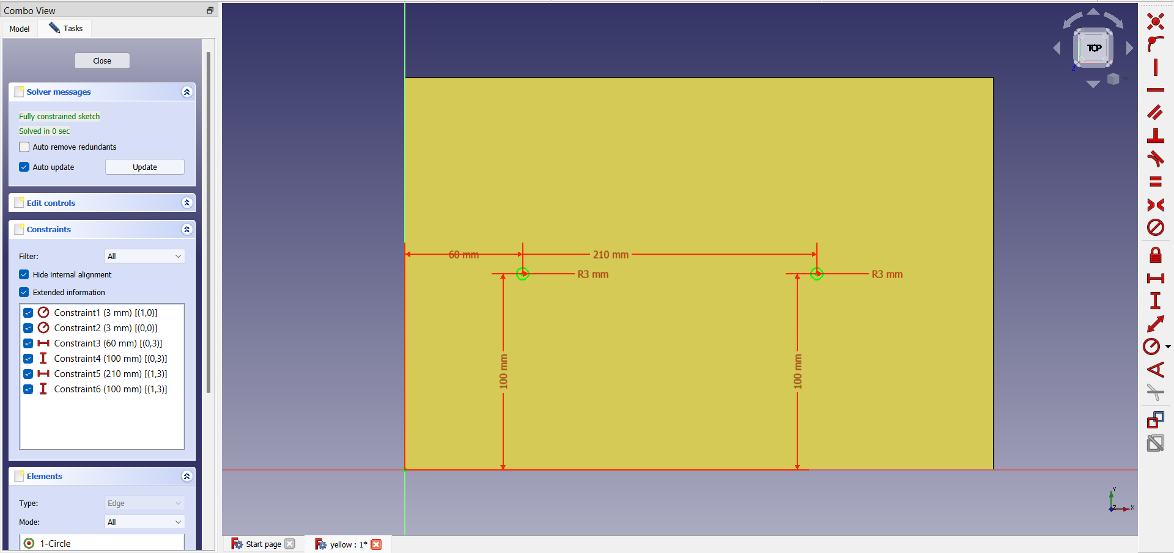
Draw or sketch two circles of radius 3mm, one at a distance of 60mm from the vertical axis, 100mm from the horizontal axis, another at 210mm from the vertical axis and 100mm from the horizontal axis. And then pocket the sketches to depth of 15mm.

Slide 29
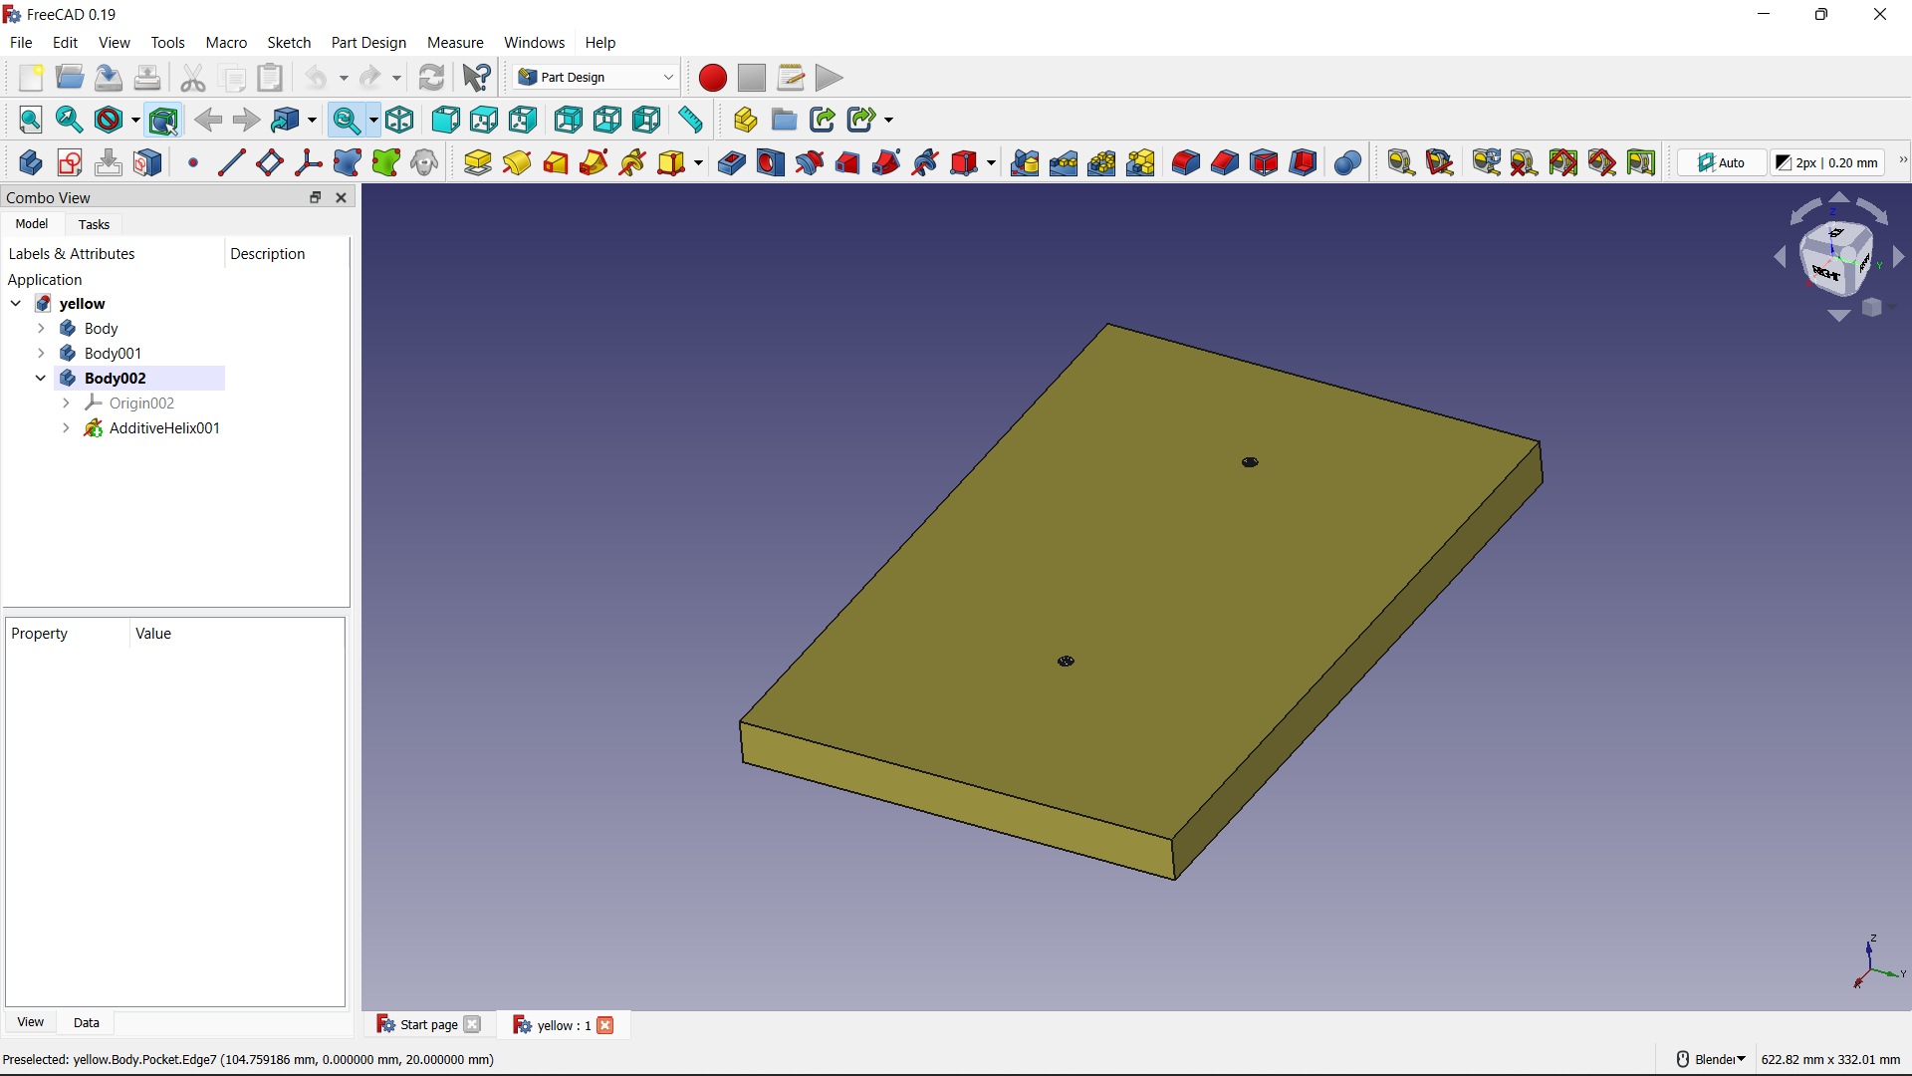
Now add two threaded helices and then use additive sweep option to create a similar structure ( pitch = 0.075, height = 15mm ) which we use to fix this to another part using a bolt or a screw.
The final output of the yellow body looks like this.

Slide 30
SCREW
MODELLING

Slide 31
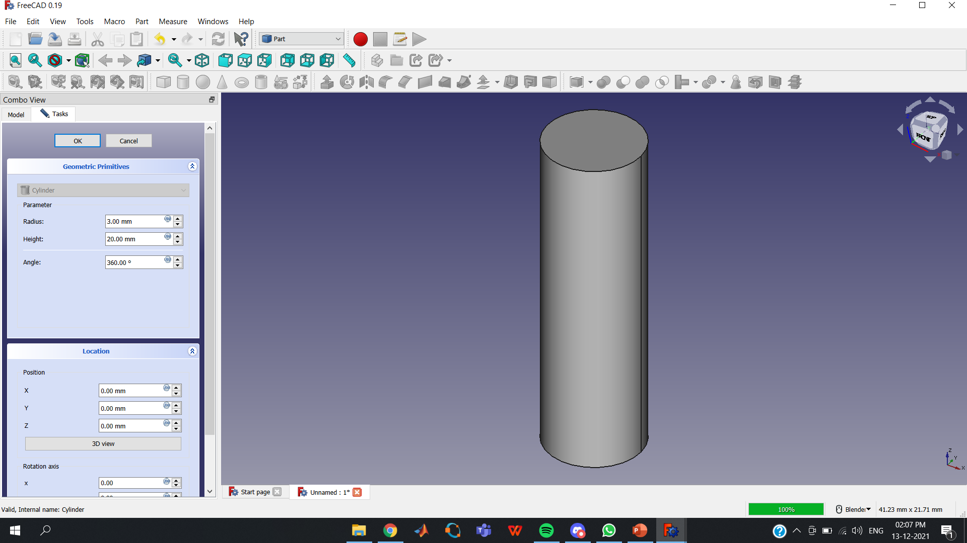
Next we will see how to model a bolt . First Create a Cylinder of radius 3mm and height 15mm.

Slide 32
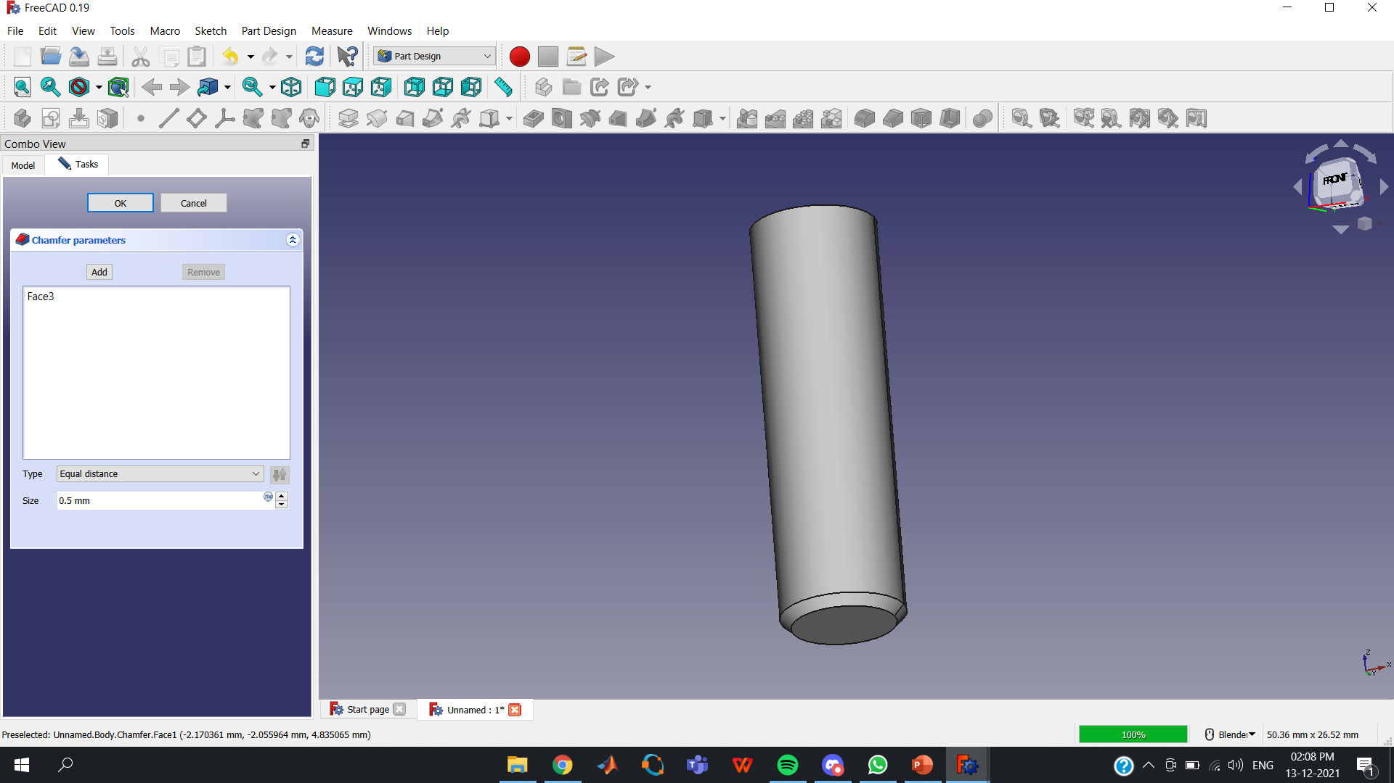
Now create a chamfer on the bottom of the cylinder and give the size of the chamfer as 0.5 mm

Slide 33
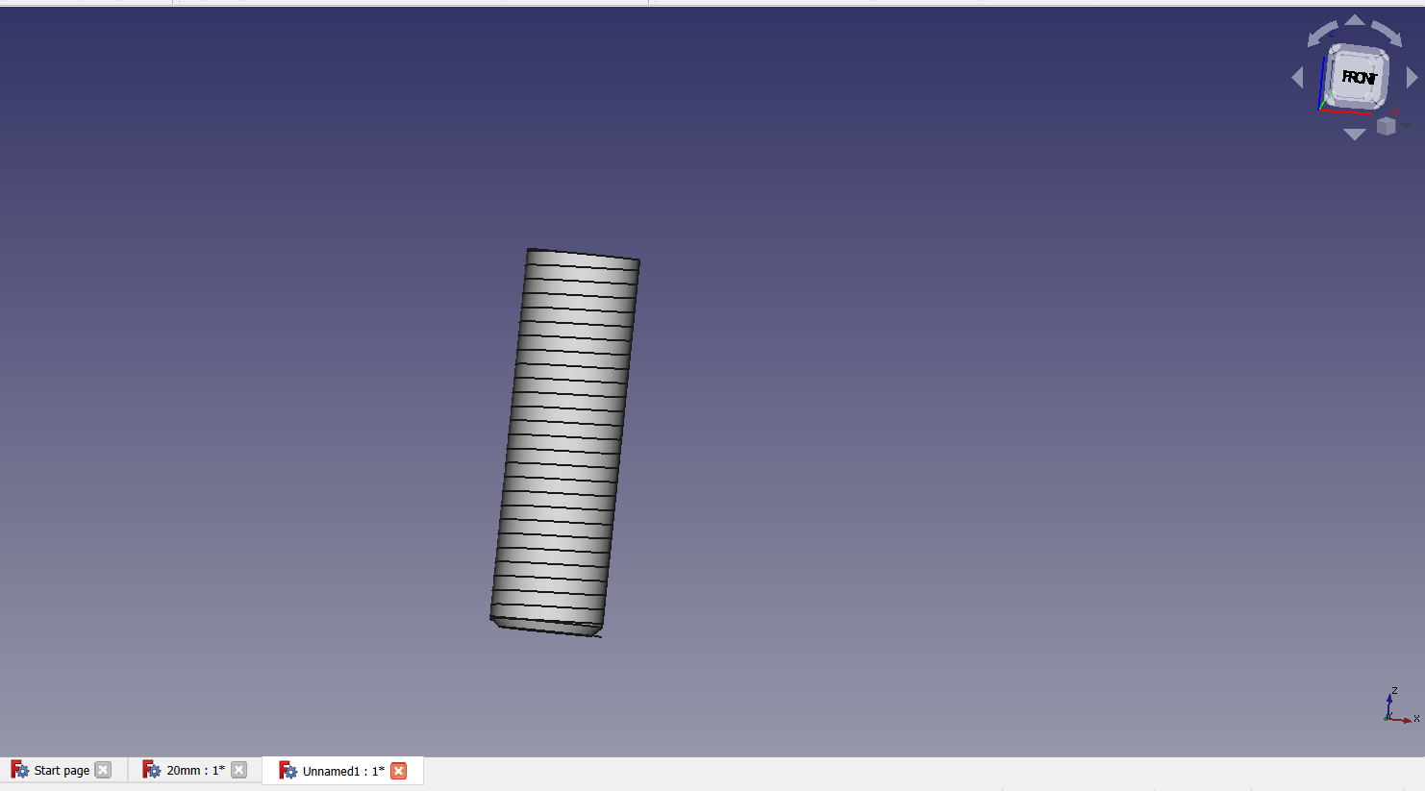
Next to create a helix select the option Helix in creation of parameterized geometric primitives which can found in Part and give the values Pitch = 0.075 , Height = 15mm and Radius = 3mm. After that we will get helix as shown in the figure.

Slide 34
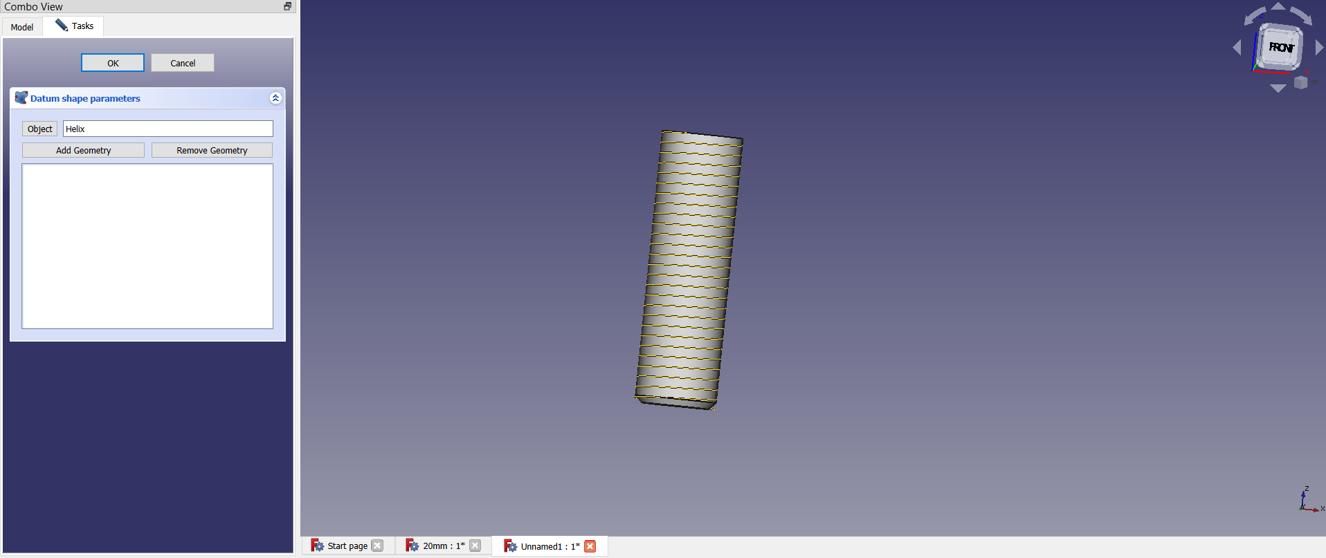
Next we will create a shape blinder. and select the object as helix

Slide 35
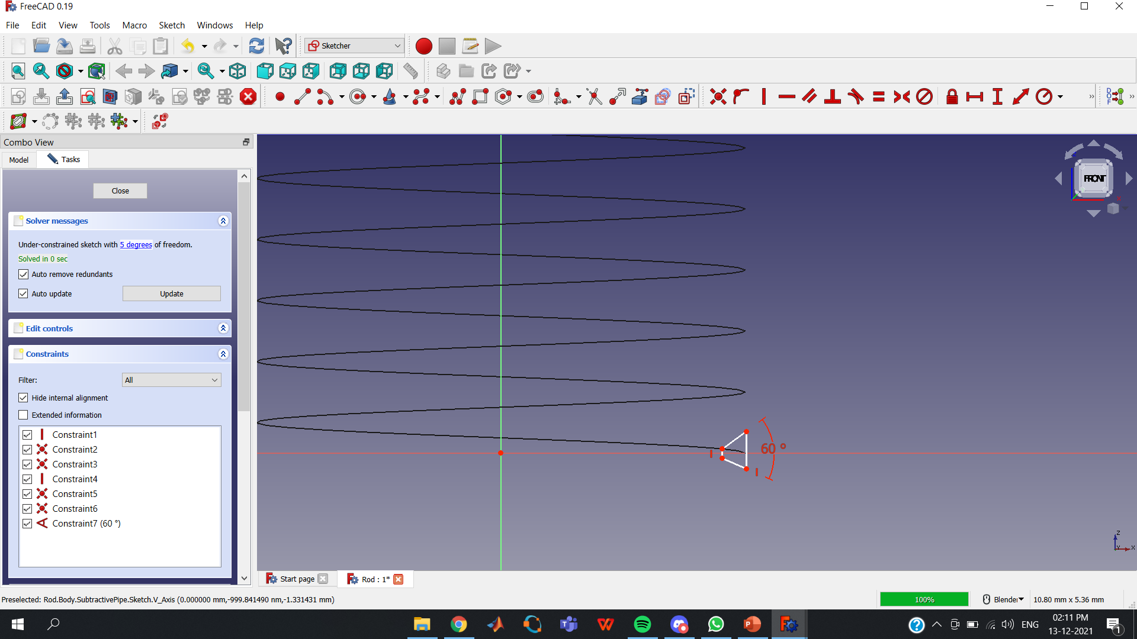
To give the Helix the shape of thread, we will sketch a trapizeum. For that first select create a edge linked to an external geometry option in sketcher and create a point then sketch a trapezium using that point as shown below.

Slide 36
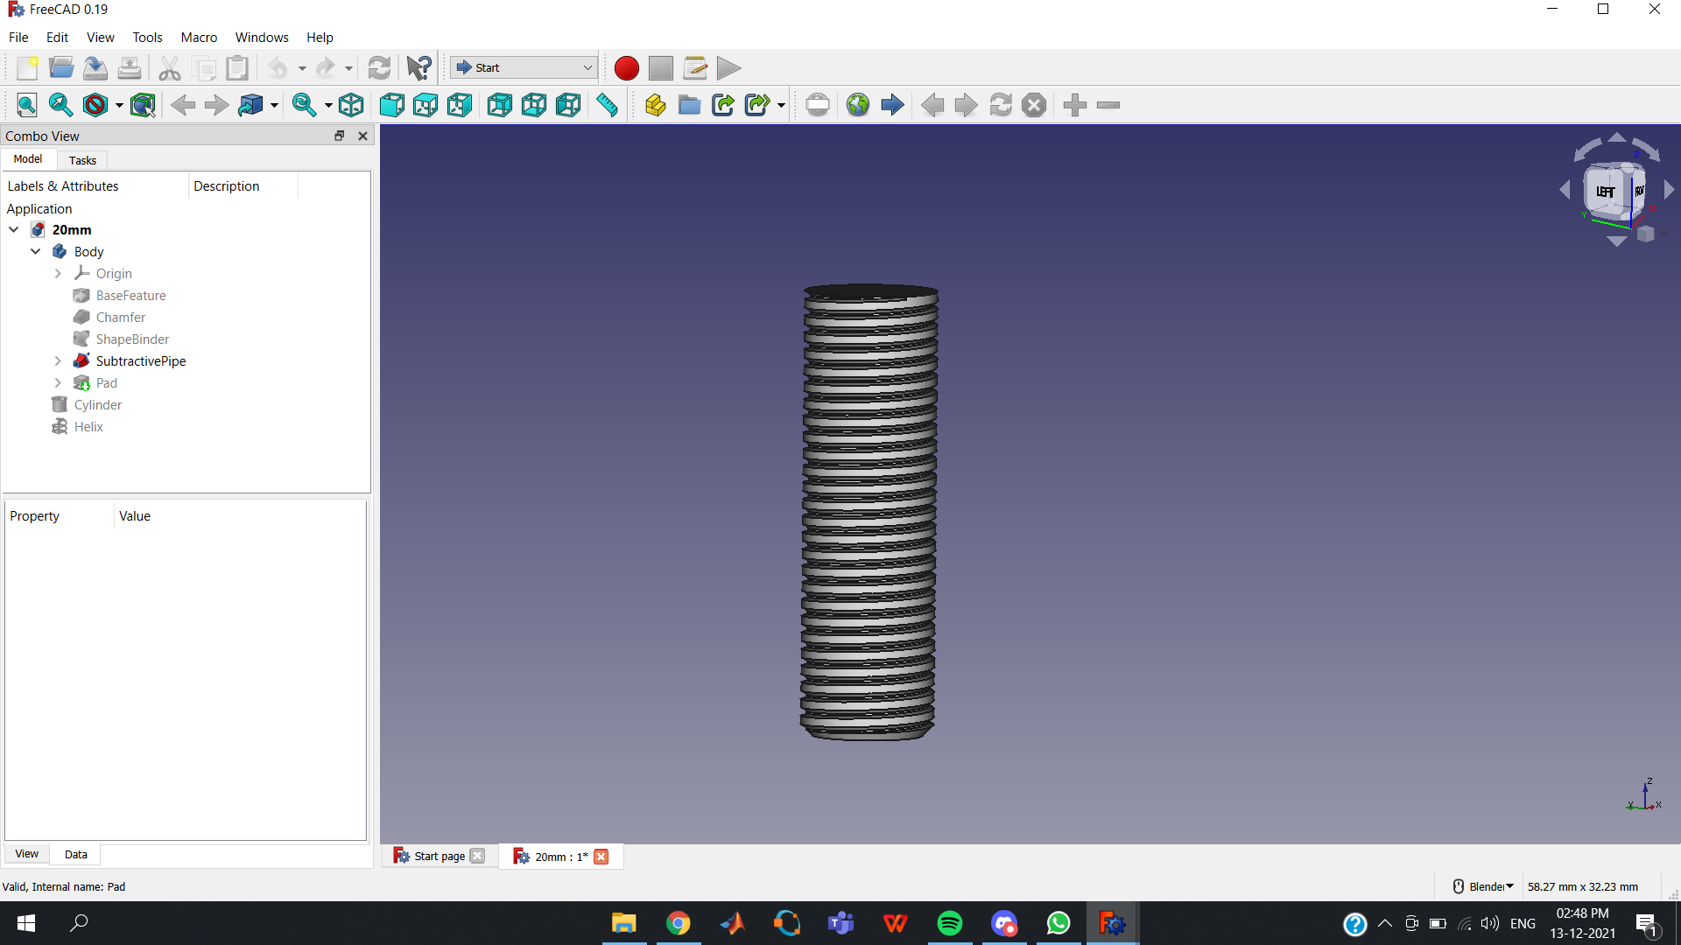
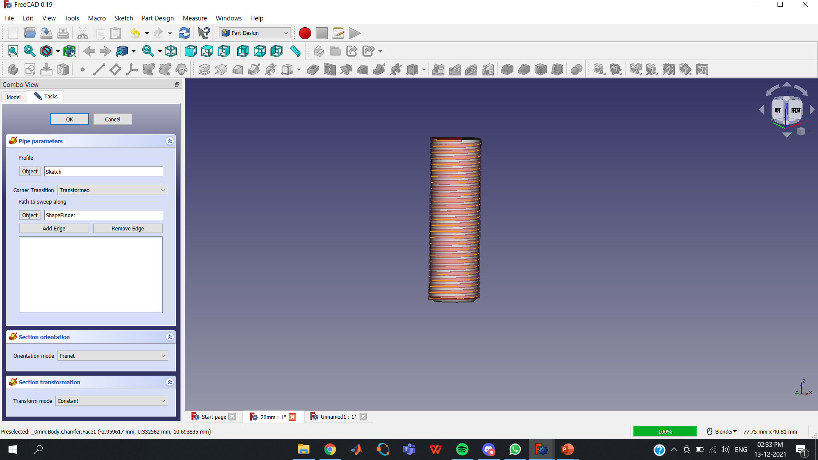
Next create a Subtractive Pipe and select the object as Helix and change the Orientation Mode to Frenet. The result is as shown in the figure.

Slide 37
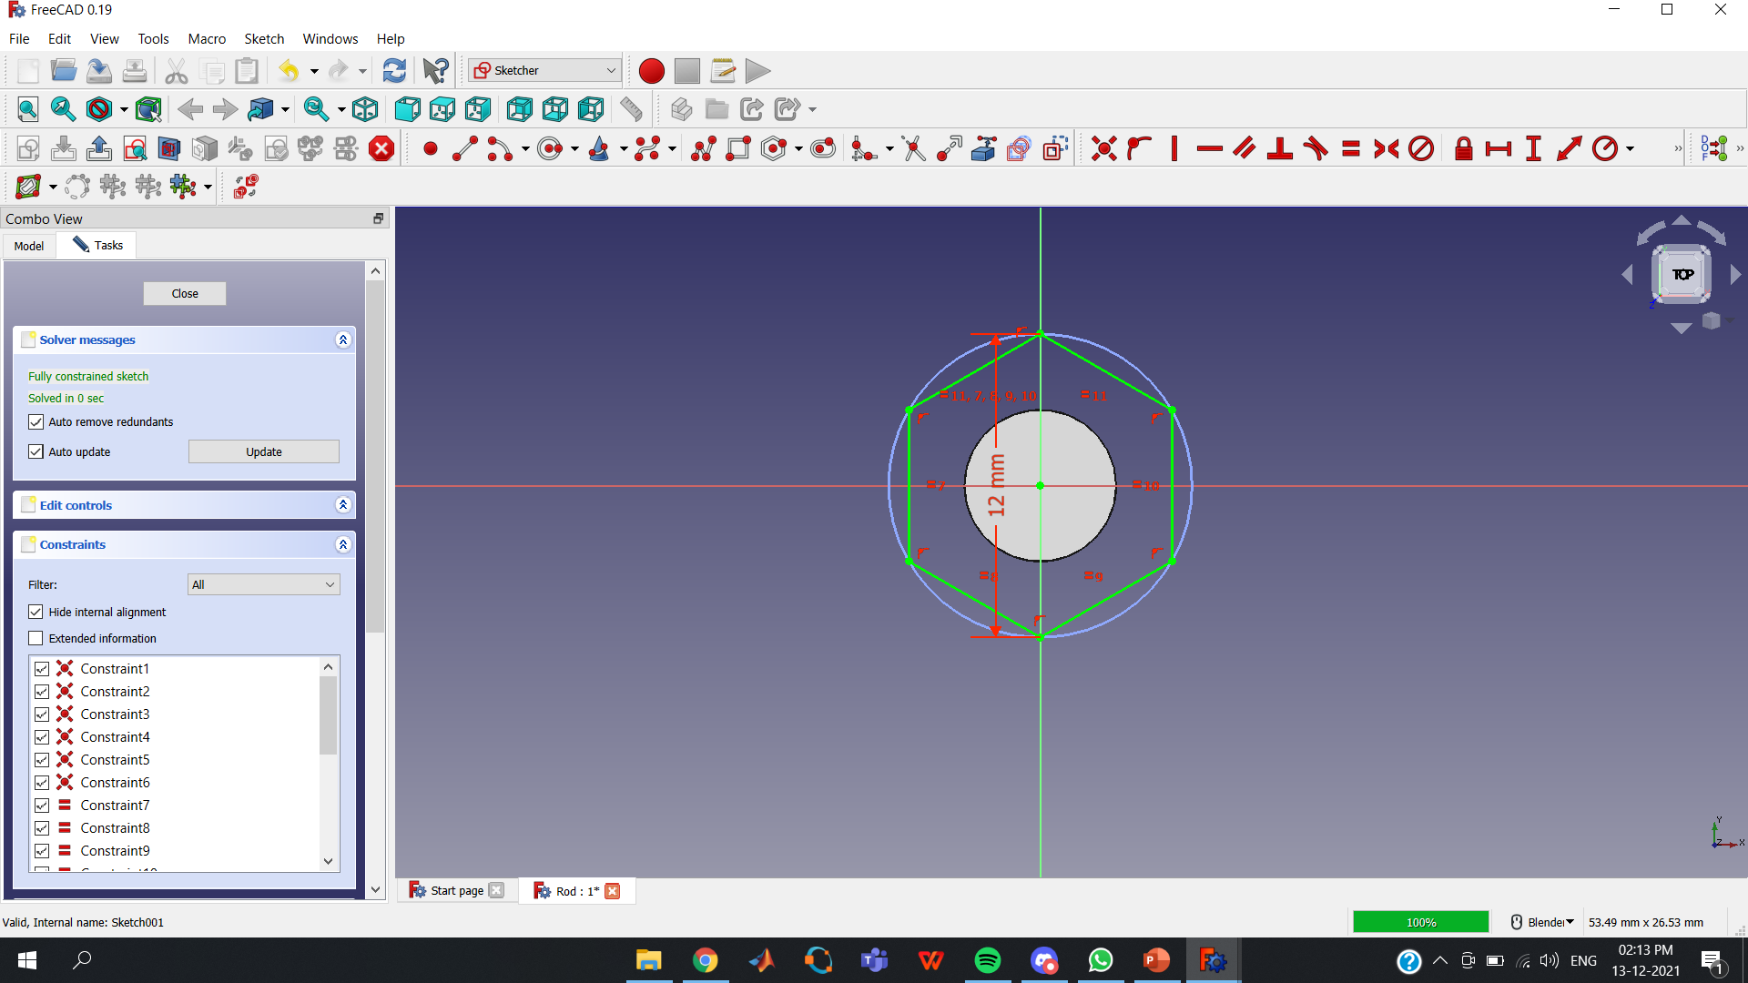
Now sketch a Hexagon on the top of the cylinder and Pad it with a length of 5mm.

Slide 38
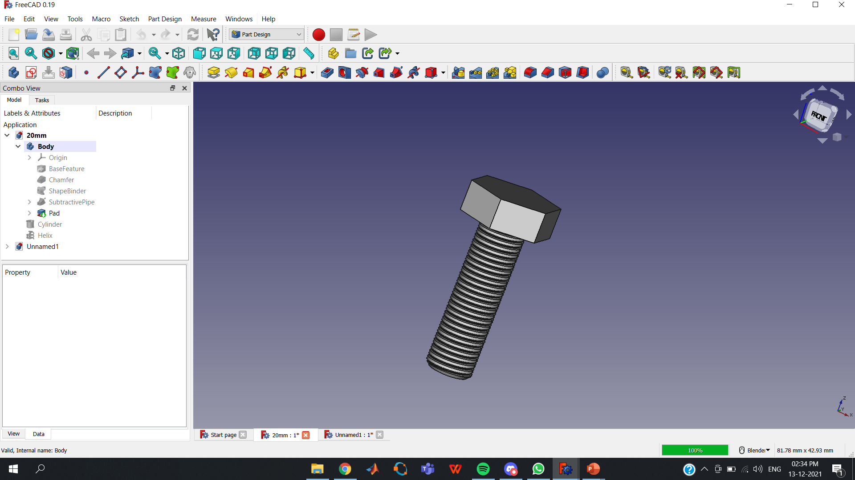

Slide 39
BOLT
MODELLING

Slide 40
Next we will see how to model a bolt . First Create a Cylinder of radius 3mm and height 20mm.

Slide 41
Now create a chamfer on the bottom of the cylinder and give the size of the chamfer as 0.5 mm

Slide 42
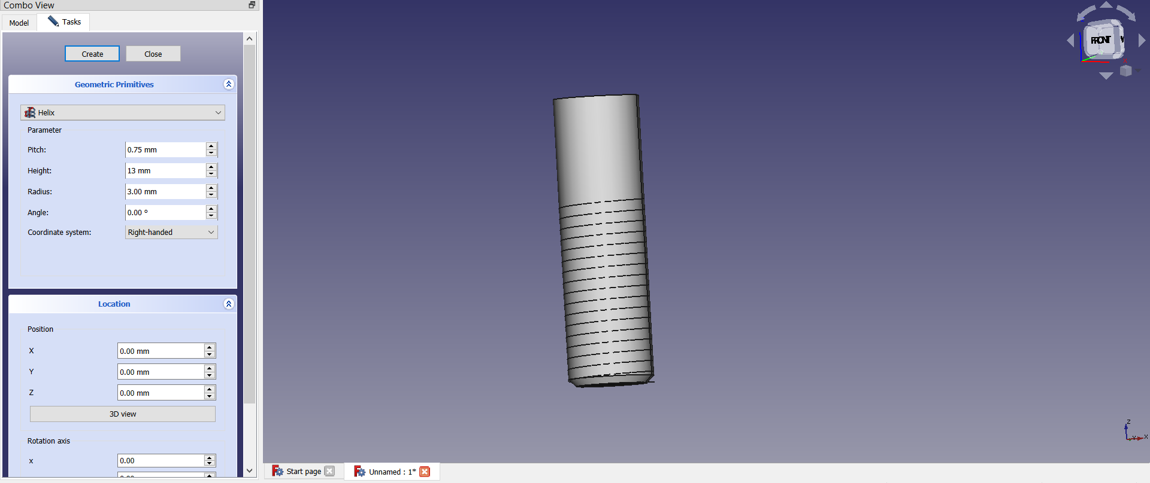
Next to create a helix select the option Helix in creation of parameterized geometric primitives which can be found in Part and give the values Pitch = 0.075 , Height = 13mm and Radius = 3mm. After that we will get helix as shown in the figure.

Slide 43
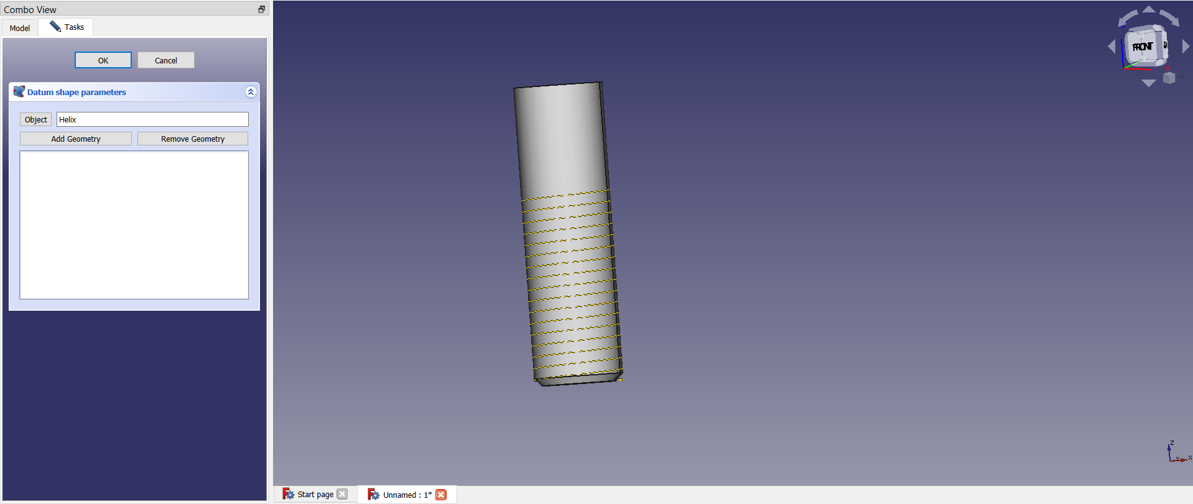
Next we will create a shape binder. and select the object as helix

Slide 44
To give the Helix the shape of thread, we will sketch a trapezium. For that first select create a edge linked to an external geometry option in sketcher and create a point then sketch a trapezium using that point as shown below.

Slide 45
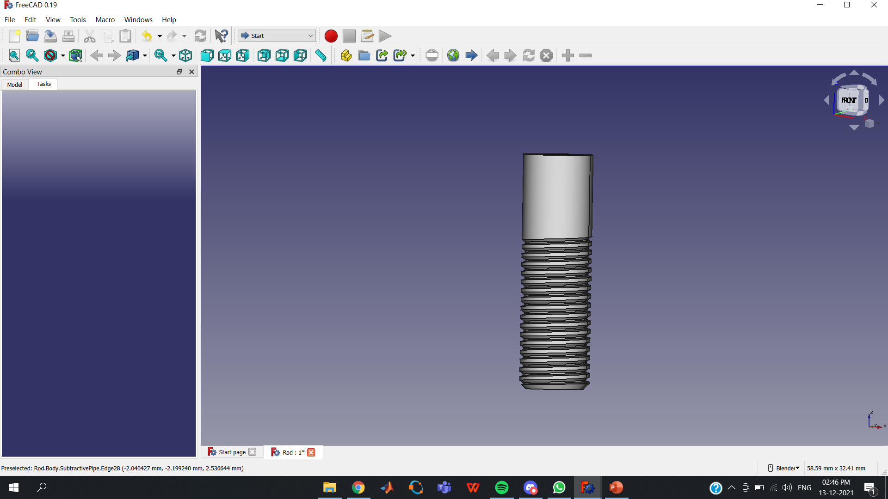
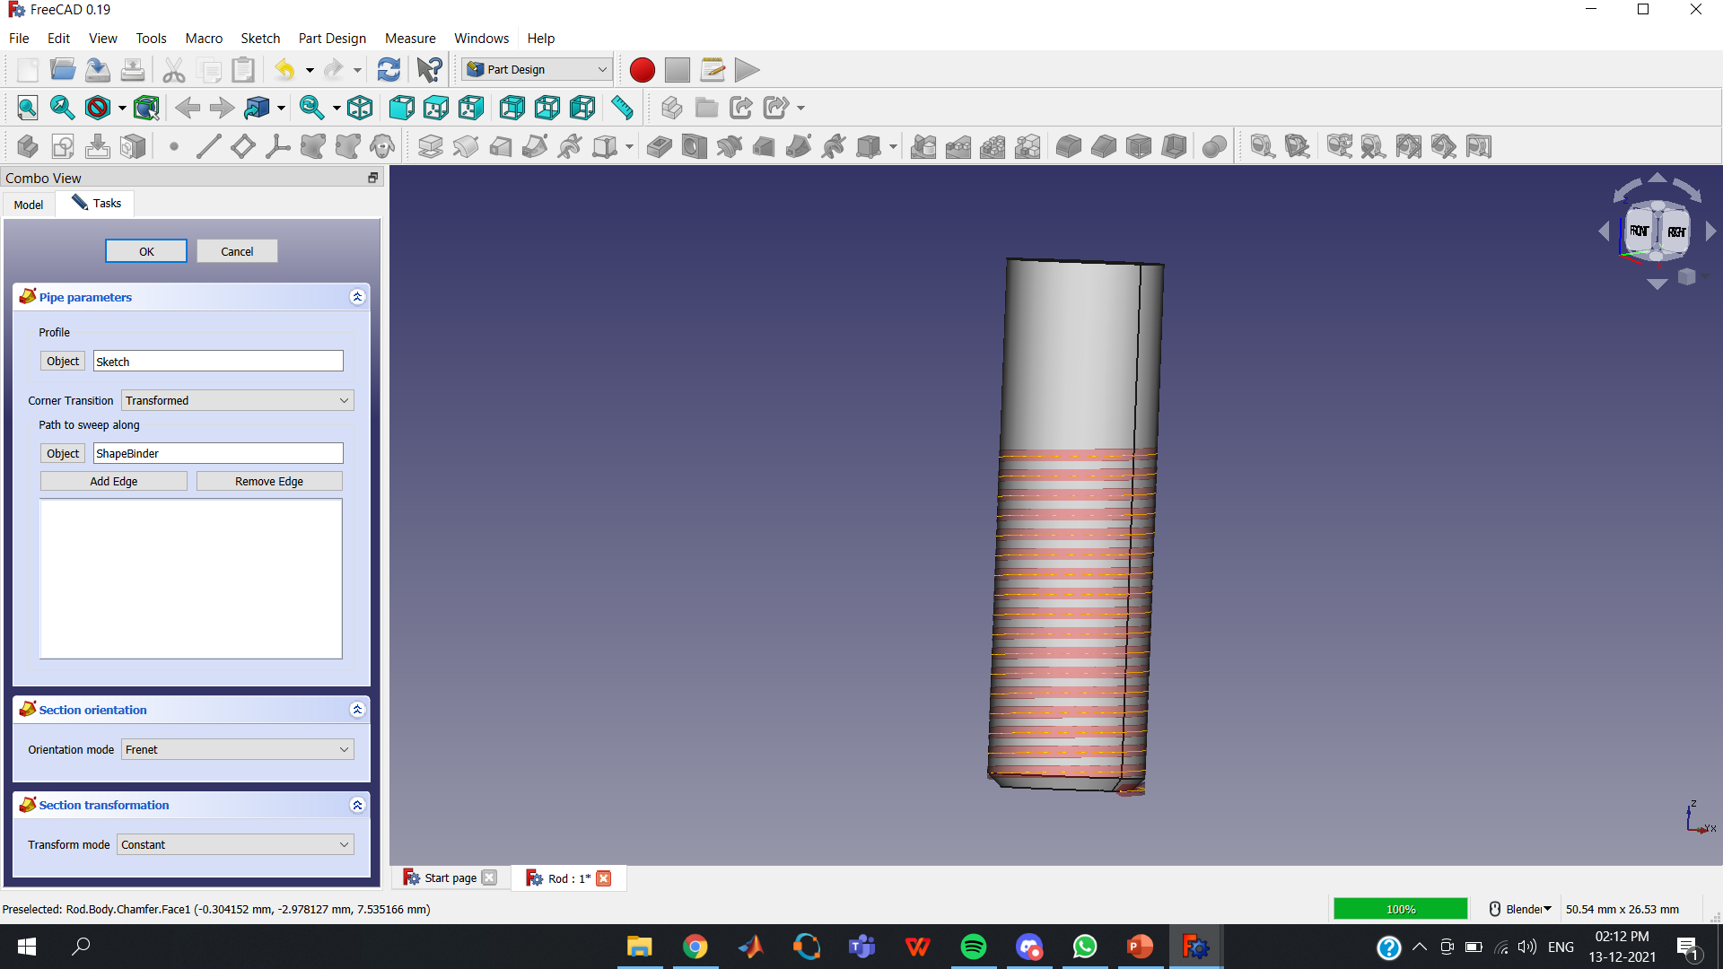
Next create a Subtractive Pipe and select the object as Helix and change the Orientation Mode to Frenet. The result is as shown in the figure.

Slide 46
Now sketch a Hexagon on the top of the cylinder and Pad it with a length of 4mm. Then increase the length of the cylinder to 40mm as we need a bolt of length 40mm.

Slide 47
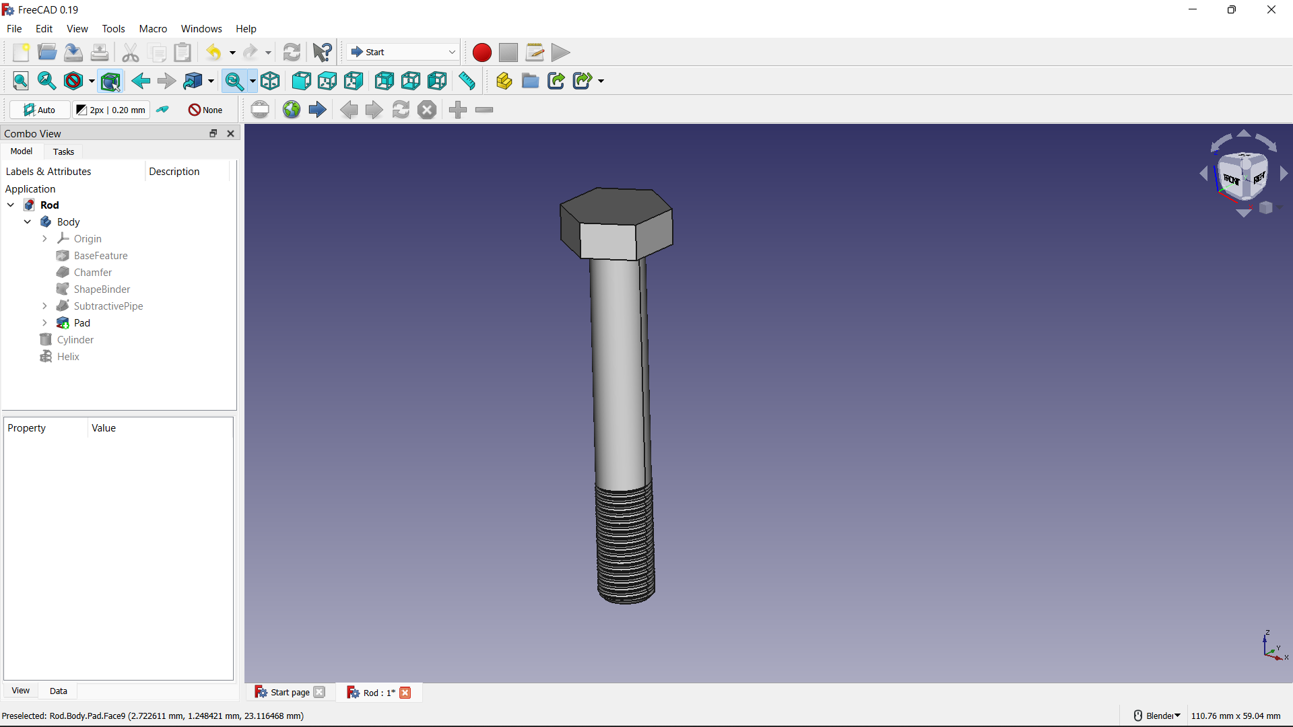

Slide 48
NUT
MODELLING

Slide 49
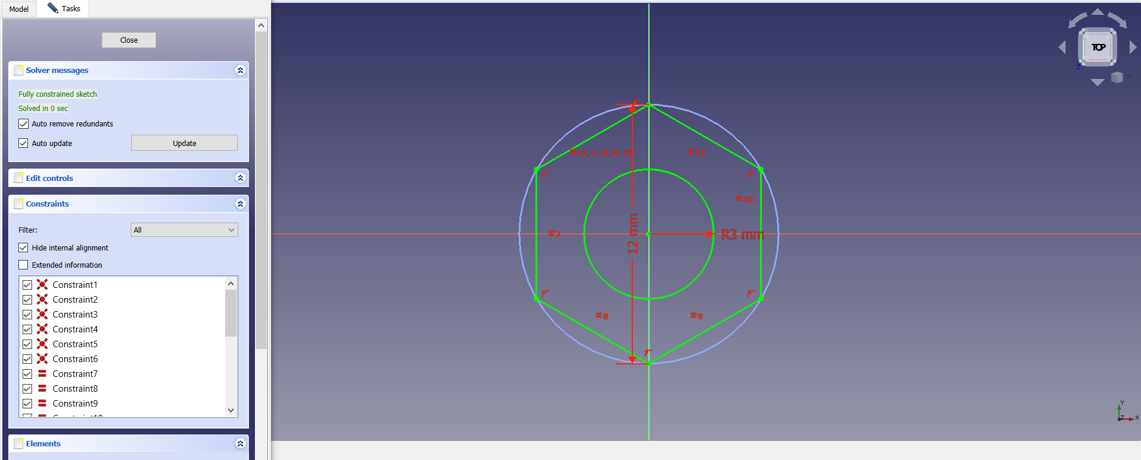
First we will model a nut. For that we have to Sketch a hexagon of length 12mm and also sketch a circle of radius 3mm as shown in the figure.

Slide 50
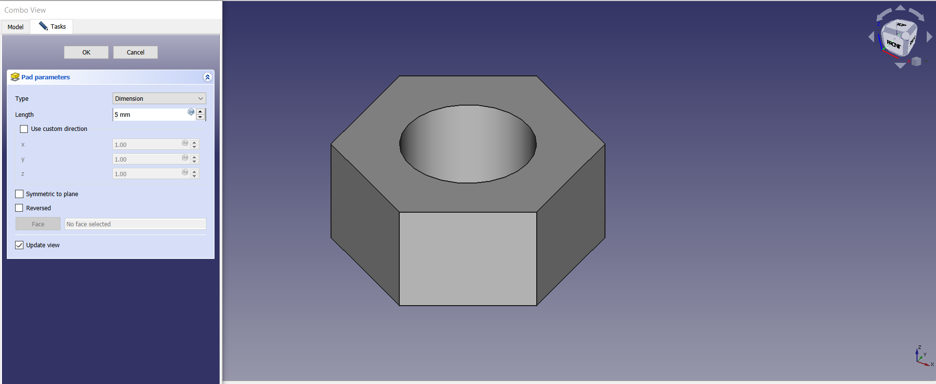
Now Pad the sketch we created above and pad it with a length of 5mm.

Slide 51
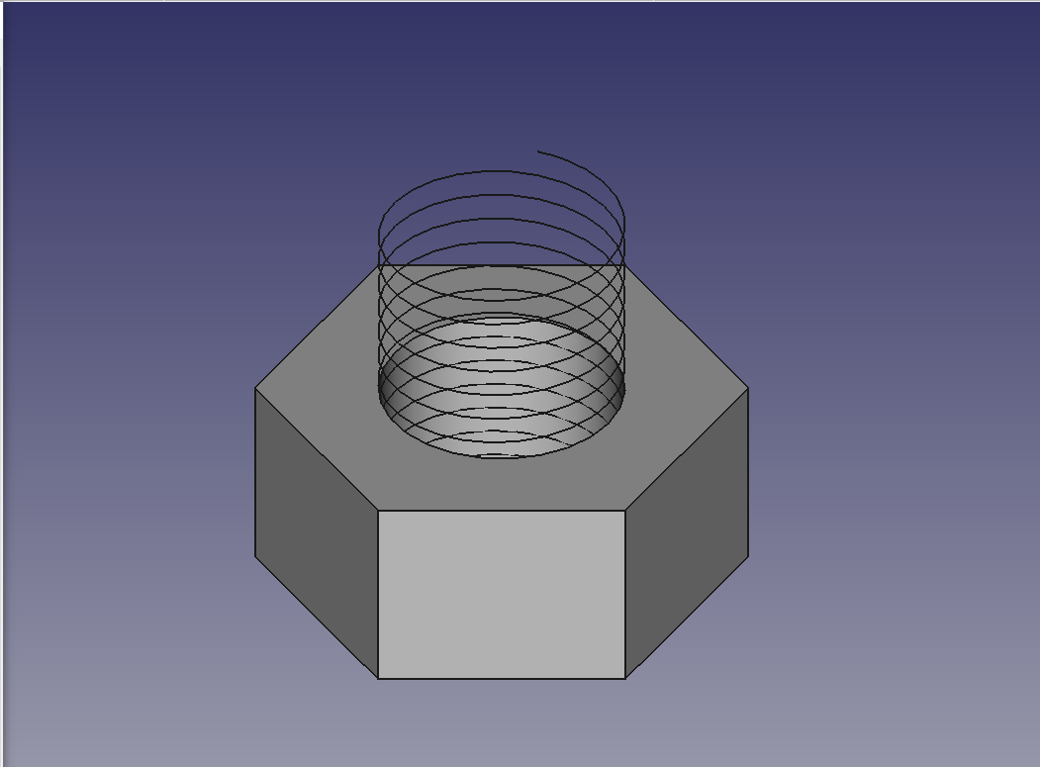
Next select the option Helix in creation of parameterized geometric primitives and give the values Pitch = 0.075, Height =12mm and Radius = 3mm.

Slide 52
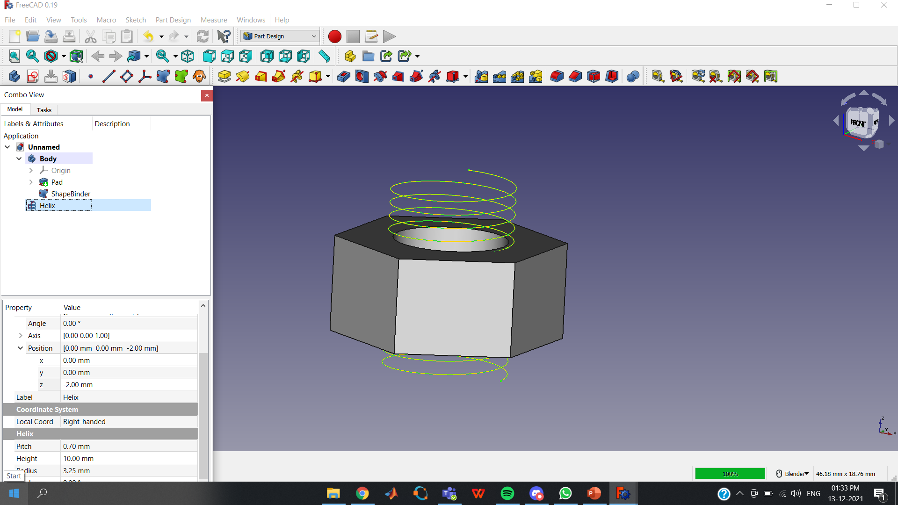
Next we will create a shape blinder and select the object as helix and also adjust the helix such that it passes throughout the nut as shown.

Slide 53
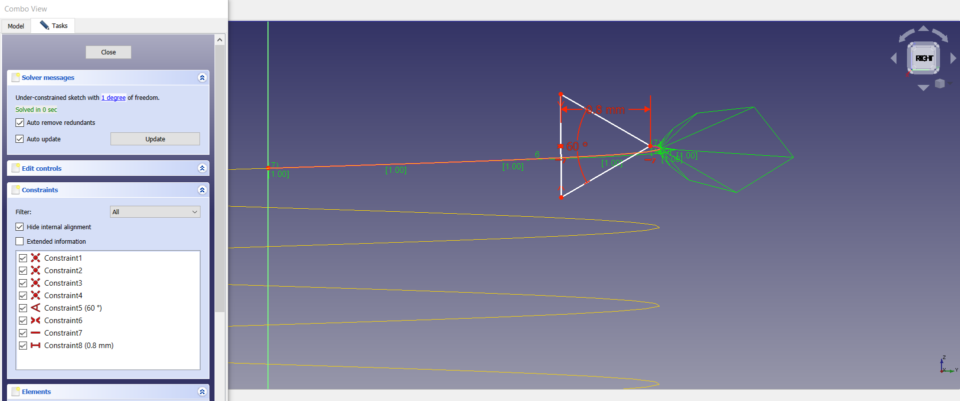
Now we need to sketch a triangle at the top of the helix to shape it like a thread. For that first select and create an edge linked to an external geometry option in sketcher and create a point then sketch a triangle using that point with an included angle 60˚.

Slide 54
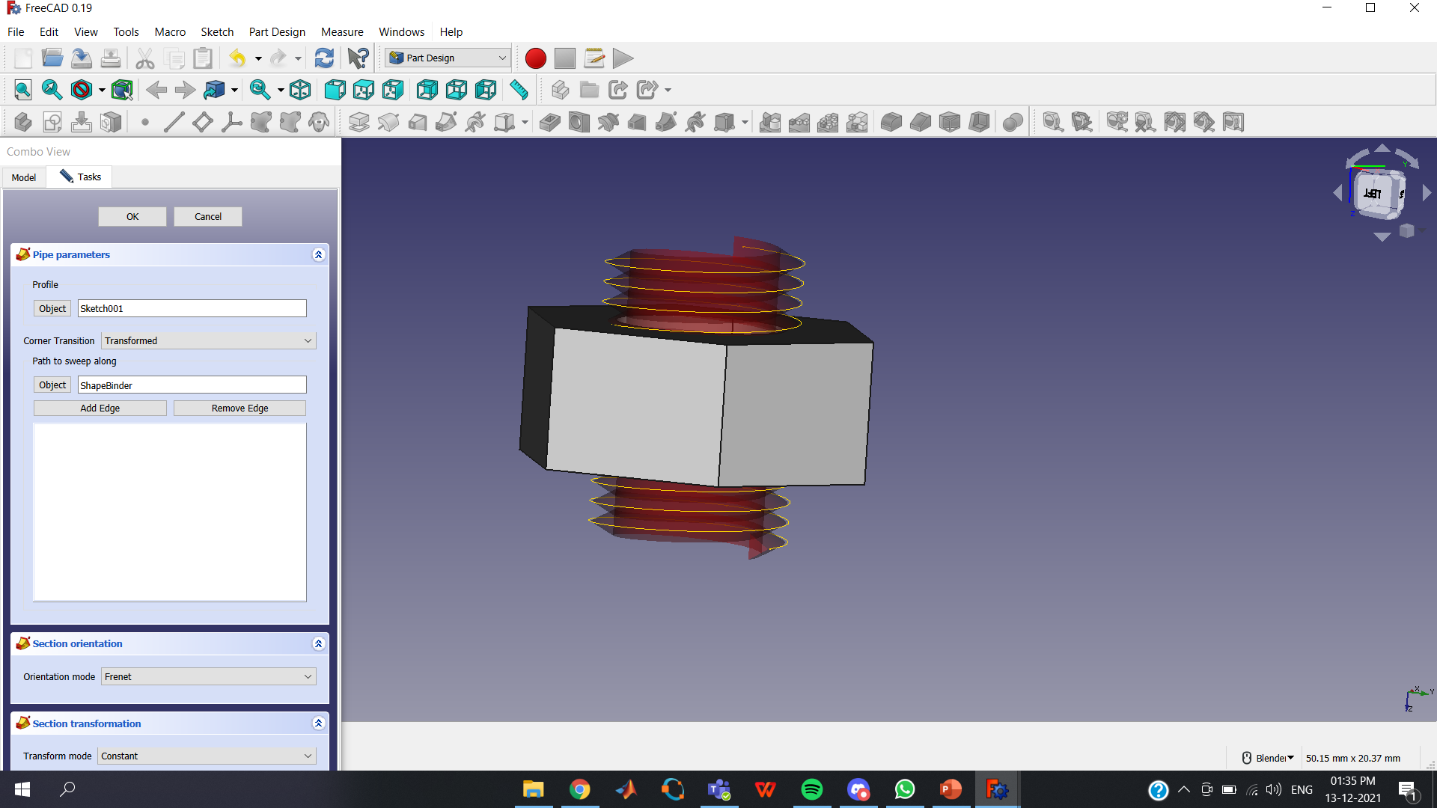
Next create a Subtractive Pipe for the sketch that we have drawn above and select the object as shape blinder and change the Orientation Mode to Frenet.

Slide 55
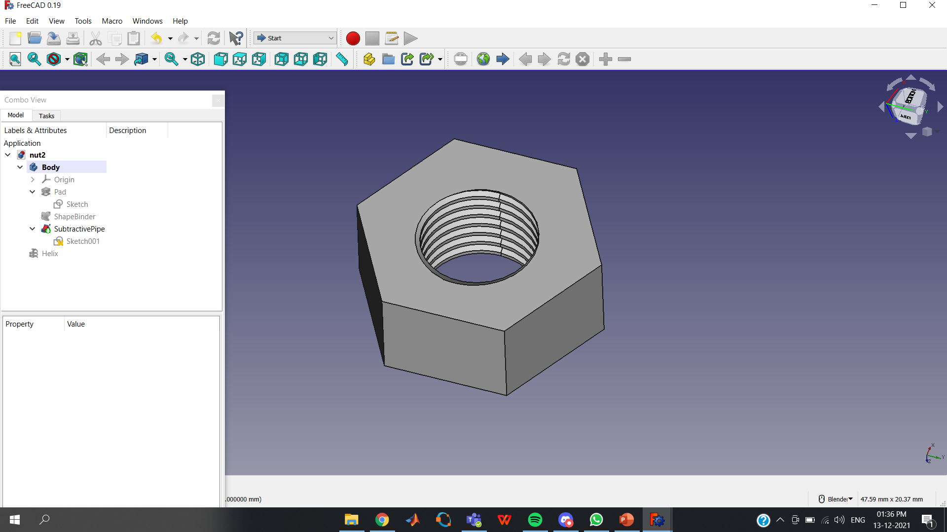

Slide 56
QUICK OVERVIEW
CREATED MODELS

Slide 59
ASSEMBLY
MAKING THE FOLDING BRACKET WITH ITS CONSTITUENT PARTS

Slide 60
PLACEMENTS OF THE COMPONENTS OF THE MODEL
BODY | AXIS | ANGLE | POSITION
BLUE | (0,0,1) | 0 | (0,0,0)
GREEN | (0,0,1) | 0 | (150,135,30)
PINK | (1,0,0) | 180 | (150,161,66)
YELLOW | (1,0,0) | 180 | (150,250,86)
SCREW GB1 | (0,0,1) | 0 | (195,150,18)
SCREW GB2 | (0,0,1) | 0 | (320,150,18)
SCREW PY1 | (1,0,0) | 180 | (210,150,78)
SCREW PY2 | (1,0,0) | 180 | (360,150,78)
NUT | (1,0,0) | 90 | (165,170,45)
BOLT | (1,0,0) | 90 | (165,175,45)

Slide 61
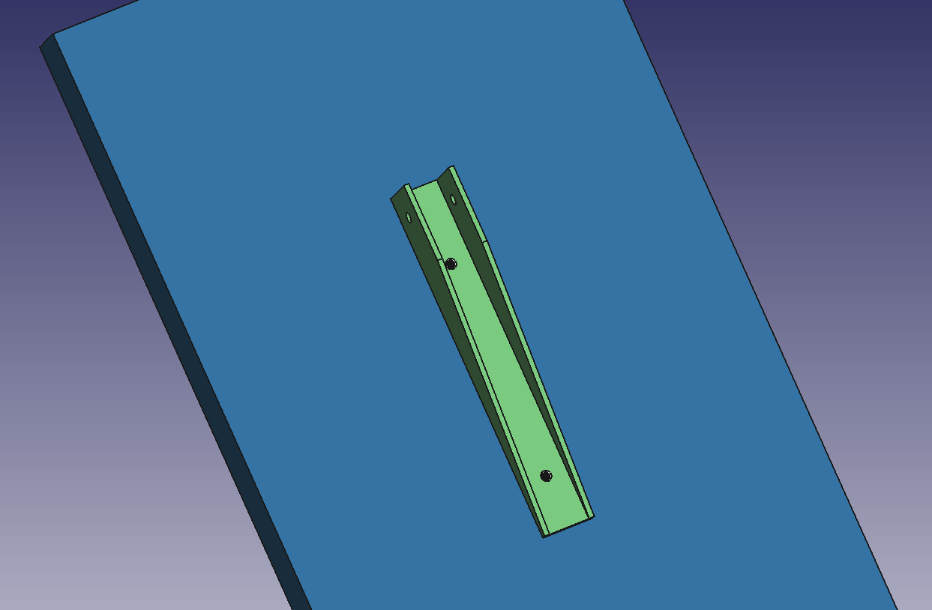

Slide 62
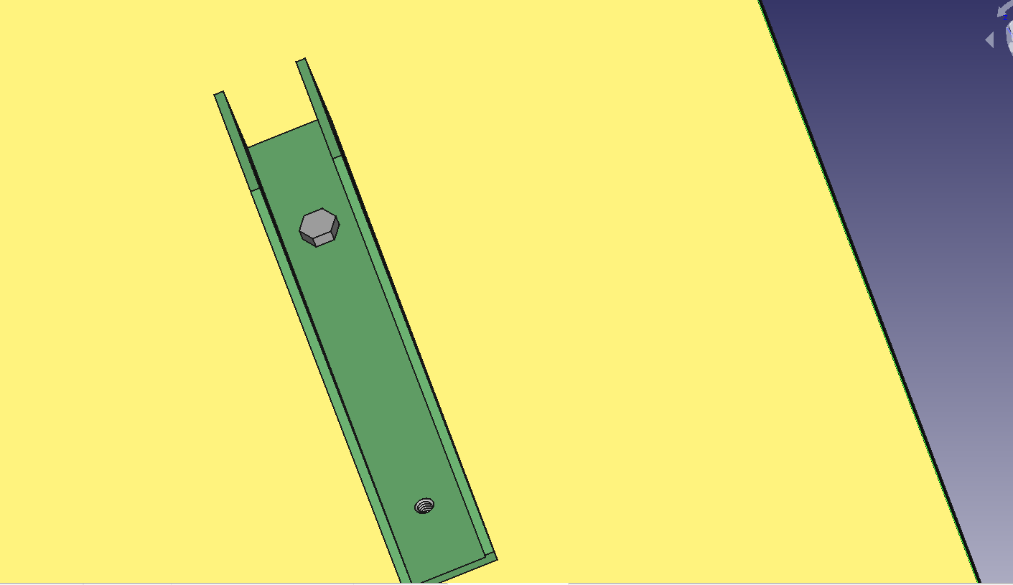

Slide 63


Slide 64


Slide 65


Slide 66


Slide 67


Slide 68


Slide 69


Slide 70


Slide 71
SLICING
SLICING OF EACH COMPONENT OF THE MODEL

Slide 72

Blue wall:
Layer height: 0.15mm ( this layer height provides a balance of speed, resolution and printing success.
Infill :100 percent infill is taken so that it makes the printed object stronger even if it takes long time.
Orientation: placed horizontally over the grid so that no need of any supports as holes are upside of the wall.
Supports: None
Platform adhesion : used brim as build adhesion. used brim. This prevents the body from warping.

Slide 73

Green bracket :
Layer height: 0.15mm
Infill :100 percent infill is taken so that it makes the printed object stronger even if it takes long time.
Orientation: placed horizontally over the grid so that it requires less no.of supports.
Supports: 2 supports are needed for the side holes of the bracket and they are normal support structures.
Platform adhesion : used brim. This prevents the body from warping.

Slide 74

Pink bracket :
Layer height: 0.15mm
Infill : 100 percent infill is taken so that it makes the printed object stronger even if it takes long time.
Orientation: placed horizontally over the grid so that it requires less no.of supports.
Supports: 2 supports are needed for the side holes of the bracket and they are normal support structures.
Platform adhesion : used brim. This prevents the body from warping.

Slide 75

Yellow pad :
Layer height: 0.15mm ( this layer height provides a balance of speed, resolution and printing success.
Infill :100 percent infill is taken so that it makes the printed object stronger even if it takes long time.
Orientation: placed horizontally over the grid so that no need of any supports as holes are upside of the wall.
Supports: None
Platform adhesion : used brim as build adhesion. This prevents the body from warping.

Slide 76

Screw :
Layer height: 0.15mm ( this layer height provides a balance of speed, resolution and printing success.
Infill :100 percent infill is taken so that it makes the printed object stronger even if it takes long time.
Orientation: placed in a way that the hexagonal face touches the print bed so that no supports are needed.
Supports: none.
Platform adhesion : used brim as build adhesion. This prevents the body from warping.

Slide 77

Bolt :
Layer height: 0.15mm ( this layer height provides a balance of speed, resolution and printing success.
Infill :100 percent infill is taken so that it makes the printed object stronger even if it takes long time.
Orientation: placed in a way that the hexagonal face touches the print bed so that no supports are needed.
Supports: none
Platform adhesion : used brim as build adhesion. This prevents the body from warping.

Slide 78

Nut :
Layer height: 0.15mm
Infill : 100 percent infill is taken so that it makes the printed object stronger even if it takes long time.
Orientation: placed directly over the grid so that it doesn’t need any support.
Supports: None
Platform adhesion : used brim. This prevents the body from warping.

Slide 79

THANK YOU

